Slide 1
Chapter 27 Protein Metabolism
1. A brief history of understanding protein metabolism
2. The studies leading to the deciphering of the genetic codes
3. The pathway leading to the synthesis of a functional protein
4. Current understanding on protein targeting and degradation

Slide 2
1. Translation (protein synthesis) necessitates the coordinated interplay of about 300 macromolecules in the cells
The most complex pathway of all biosynthetic pathways
60 to 90 macromolecules for making up the protein-synthesizing machine - ribosomes
Over 20 enzymes for activating the amino acids
Over 10 auxiliary proteins for the initiation, elongation and termination of the polypeptide chains

Slide 3
Account for up to 90% of the chemical energy used by a cell for all biosynthetic reactions
The molecules used for translation account for more than 35% of the dry weight of a bacterial cell.
However, proteins are synthesized with very high efficiency: a complete polypeptide chain of 100 residues is synthesized in about 5 seconds in an E.coli cells at 37ºC.

Slide 4
2. The molecular mechanism of protein synthesis was mainly revealed during the 2nd half of the 20th century
Ribonucleoprotein particles (later called ribosomes) were revealed to be the site of protein synthesis in rat liver cells, using radioactively labeled amino acids and immediate subcellular fractionations (early 1950s, by Zamecnik).
Amino acids were found to be activated by attaching to a special form of heat-stable RNA molecules (later called tRNAs) before being incorporated into polypeptides (1950s, by Hoagland and Zamecnik).

Slide 5
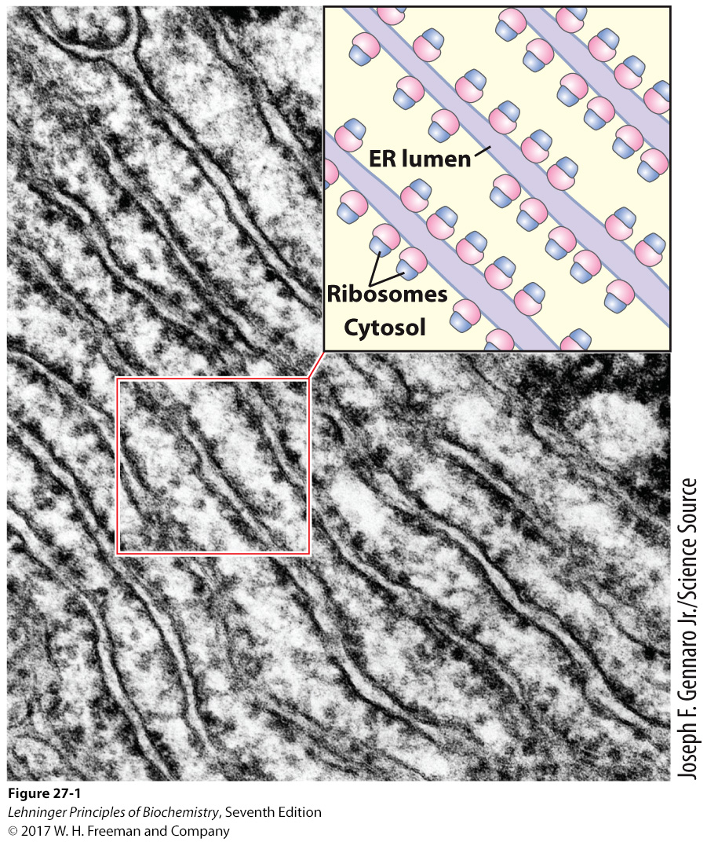
Ribosomes were revealed to be the site of protein synthesis in early 1950s (pulse labeling with radioactive amino acids and subcellular fractionations).

Slide 6
Each tRNA molecule was found to function as an adaptor (originally hypothesized by Francis Crick), carrying a specific amino acid with one site and recognizing a specific site on a template with another site.
The concept of messenger RNA (mRNA) was boldly formulated by Jacob and Monod in 1961: a short-lived RNA should serve as the information carrier between gene and protein (to explain the quick induction of proteins in E.coli).
This bold hypothesis was quickly confirmed by studies of E.coli cells infected by T₂ phages .

Slide 7
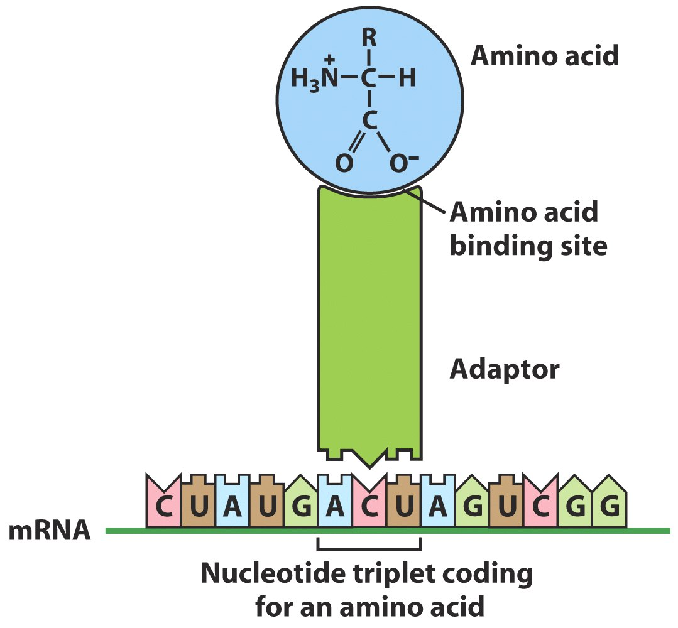
Crick’s
adaptor
hypothesis
Hydrogen
bonds
(tRNA)

Slide 8
3. Amino acids in a polypeptide chain were found to be coded by groups of three nucleotides in a mRNA
Simple calculation indicated that three or more bases are probably needed to specify one amino acid (4³=64).
Genetic studies of insertion, deletion, and substitution mutants showed codons for amino acids are triplet of nucleotides; codons do not overlap and there is no punctuation between codons for successive amino acid residues.
The amino acid sequence of a polypeptide is defined by a linear sequence of contiguous codons: the first codon establishes a reading frame.

Slide 9
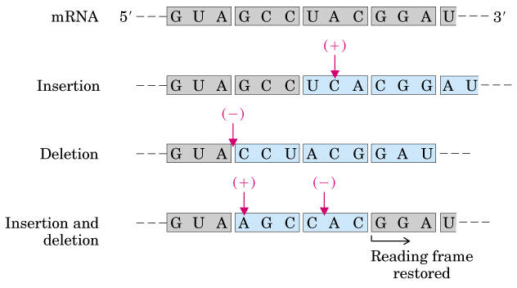
Altered amino acid sequences
Altered amino acid sequences
Genetic studies showed that genetic
codons are successive triplets of nucleotides.

Slide 10
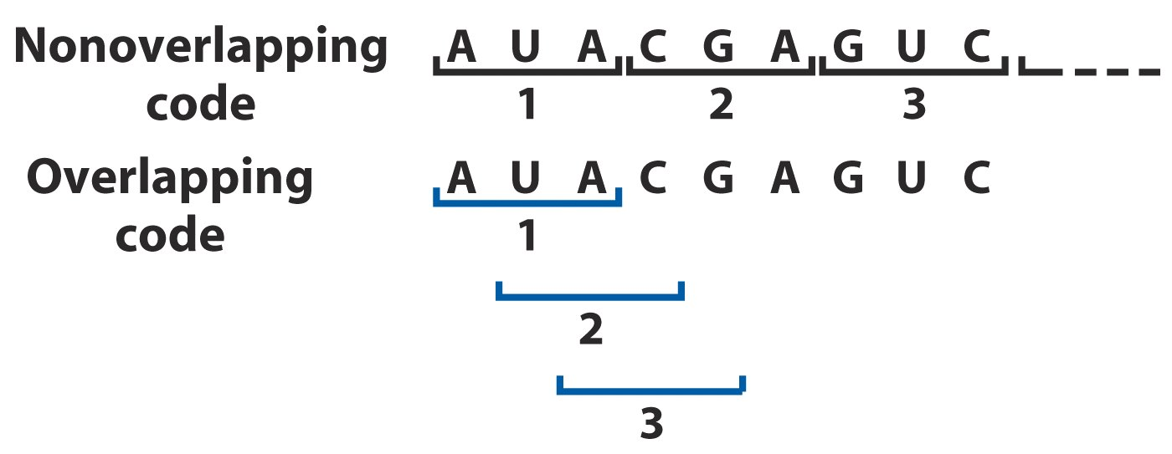
Amino acid sequence studies of tobacco mosaic
virus mutants and abnormal hemoglobins
showed that alterations usually affected only
one single amino acid: genetic codes are
nonoverlapping.

Slide 11
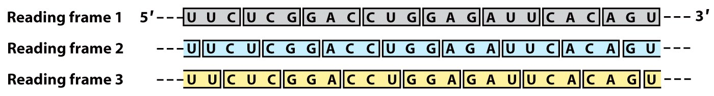
Each mRNA molecule would have three
potential reading frames (but only one
usually codes for a polypeptide chain).

Slide 12
4. The genetic codes were deciphered by simply using the in vitro protein synthesis system
Artificially synthesized poly(U), synthesized using polynucleotide phosphorylase, was added to 20 reaction tubes each containing the cell-free E.coli extract, GTP, ATP, a mixture of 20 amino acids, and one ¹⁴C labeled amino acid.
Radioactive polypeptide was only detected in the tube containing [¹⁴C]-Phe (with high concentration of Mg²⁺).
When poly (A) and poly (C) were added, radioactive polypeptides were only detected in the tubes containing ¹⁴C-labeled L-Lys and L-Pro, respectively.

Slide 13
UUU, AAA, CCC encodes Phe, Lys, and Pro, respectively.
When poly(G) was added, no polypeptides synthesized probably due to the formation of tetraplexes of the poly (G) strands.

Slide 14
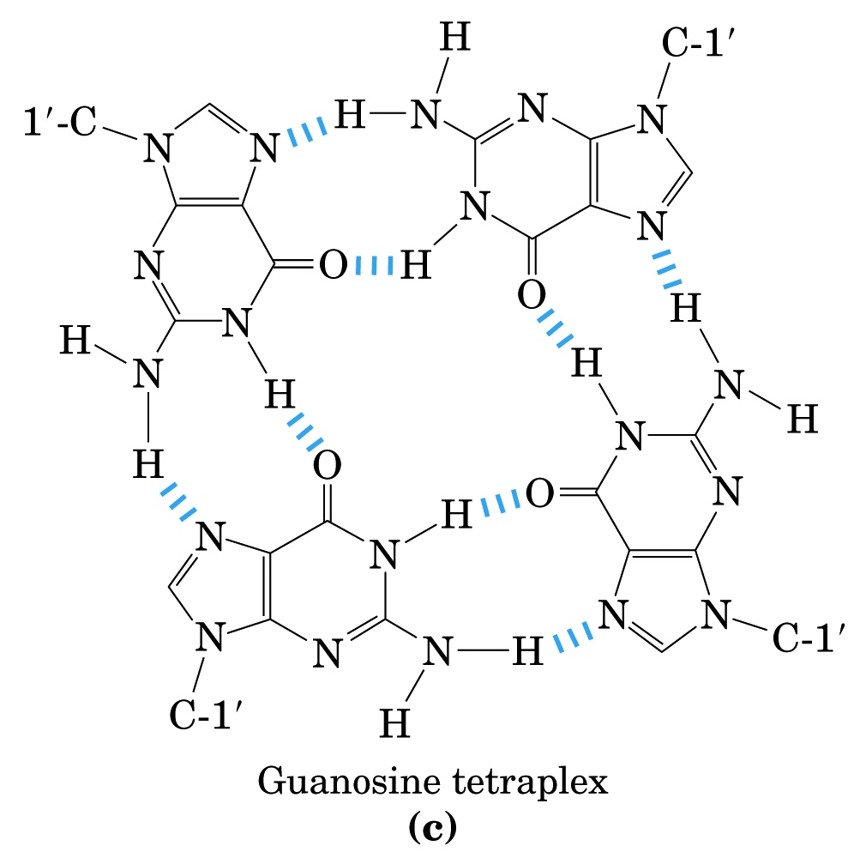

Slide 15
5. Base composition of the triplets coding for some amino acids were revealed using mixed copolymers of RNA
The composition of an RNA synthesized using polyribonucleotide phosphorylase depends on the proportion of each NDP present in the reaction mixture.
Investigation of the identity and quantity of the amino acids incorporated into the polypeptides in response to random polymers of RNA made from various ratios of NDPs can reveal the nucleotide composition (but not the exact sequence) of the triplets corresponding to certain amino acids.

Slide 16
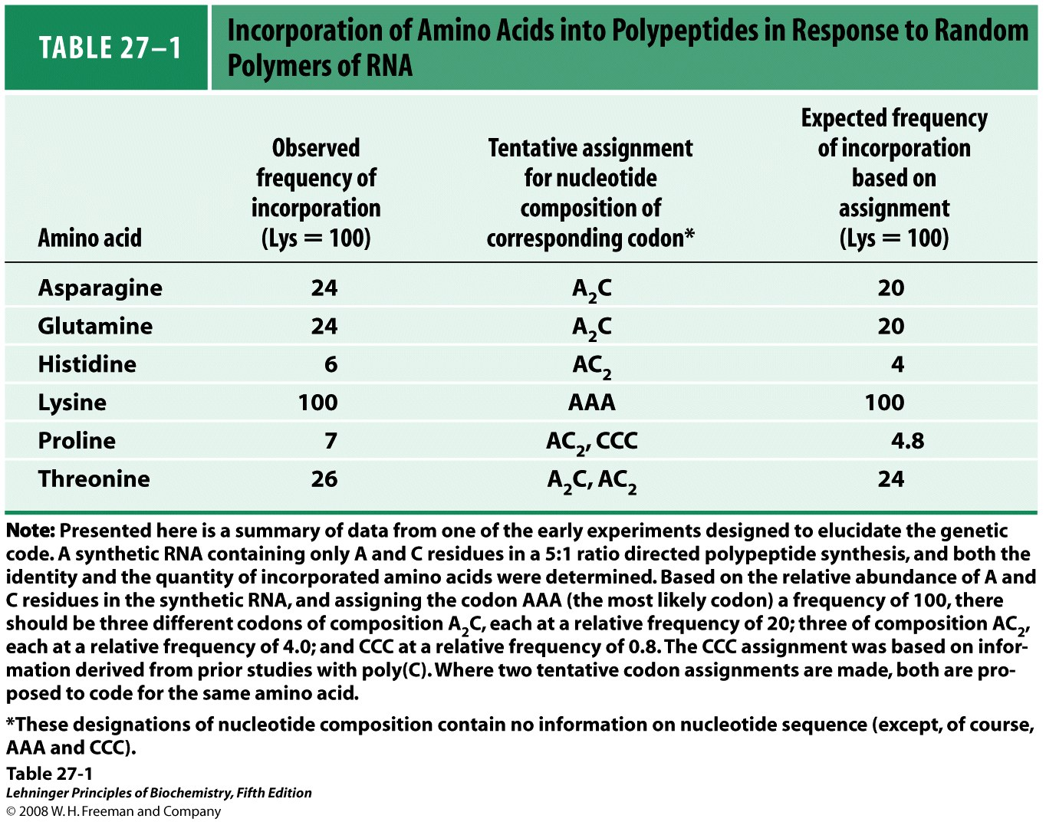
Notes:
TABLE 27-1 Incorporation of Amino Acids into Polypeptides in Response to Random Polymers of RNA

Slide 17
6. Many trinucleotides were found to promote the binding of specific aminoacyl-tRNAs to ribosomes
It was discovered in 1964 that a specific aminoacyl-tRNA would bind to the isolated ribosomes when the corresponding synthetic polynucleotide messenger or only the trinucleotide is present.
Many genetic codes were revealed by examining which aminoacyl-tRNA is bound to the ribosomes mixed with specific trinucleotides using filter-binding assay.

Slide 18
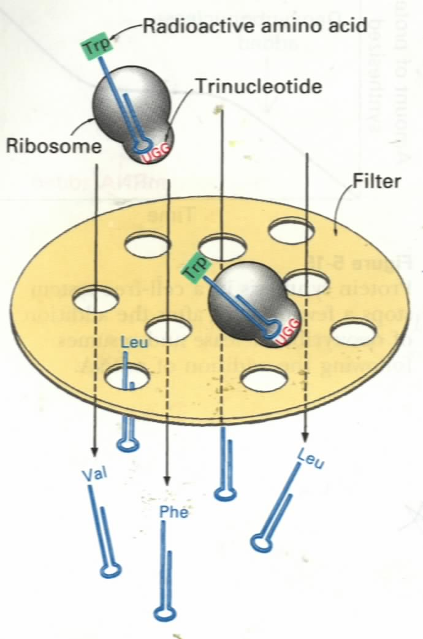
The filter-binding assay
for detecting the binding
of a trinucleotide to a
specific aminoacyl-tRNA
molecule: about 50
codons were assigned by
this simple and elegant
method.
Nitrocellulose filter

Slide 19
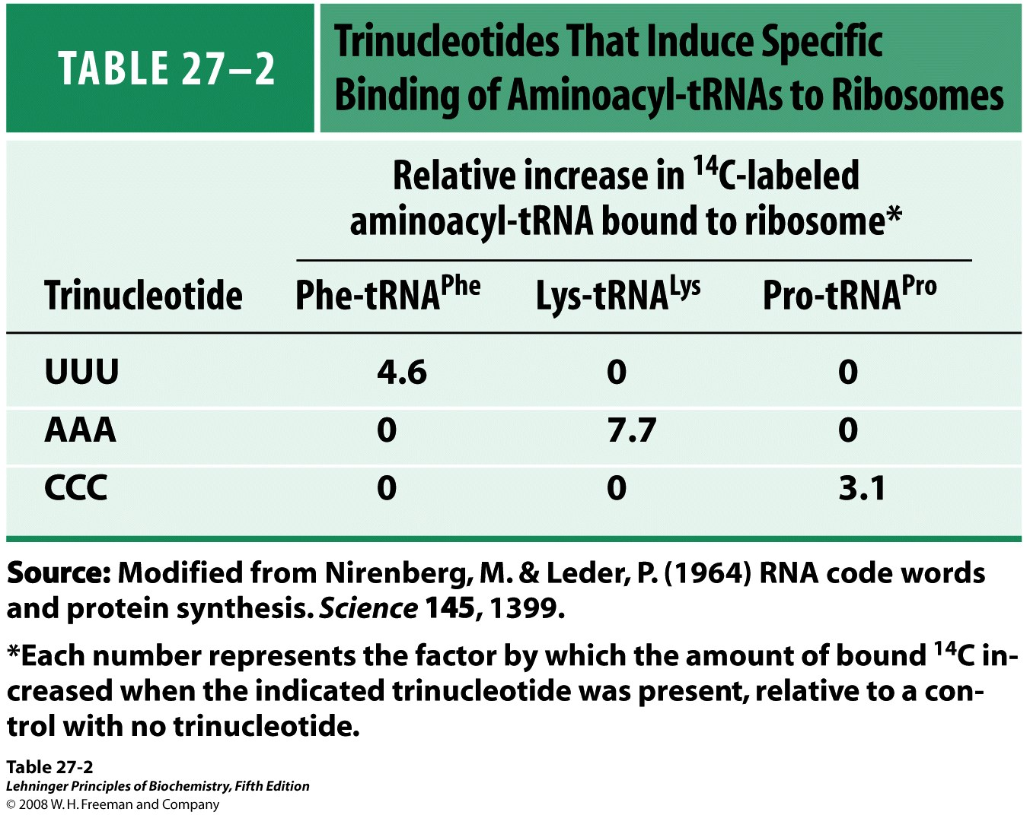
Notes:
TABLE 27-2 Trinucleotides That Induce Specific Binding of Aminoacyl-tRNAs to Ribosomes

Slide 20
7. Polyribonucleotides of defined repeating sequences of two to four bases helped to end the decoding work
Khorana successfully developed a method to synthesize polyribonucleotides of defined, repeating sequences using a combination of organic synthesis and enzymatic techniques.
Polypeptides synthesized using these poly-ribonucleotides had one or a few amino acids in repeating patterns.
Sequences for specific genetic codes can be determined by comparing the information obtained here and those obtained by using RNAs having random sequences made from two nucleotides of determined ratio.

Slide 21
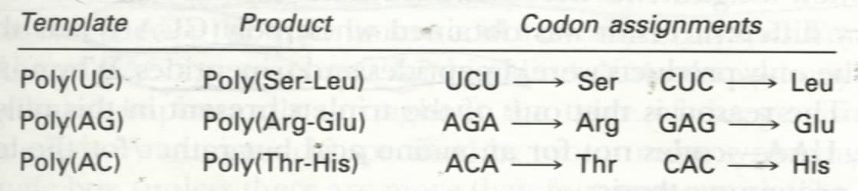
Copolymer of repeating dinucleotides always
leads to the synthesis of polypeptides of
repeating dipeptides.
ABABABABABABAB--
aa₁---aa₂---aa₁---aa₂----

Slide 22
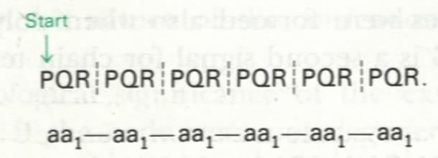
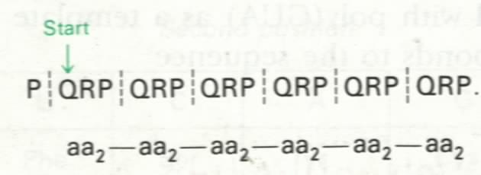
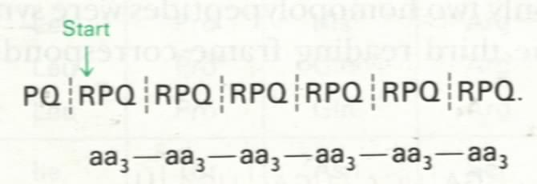
Copolymer of repeating trinucleotides leads
to the synthesis of three homopolypeptides.

Slide 23
ABCDABCDABCDABCDABCDABCDABCDABCD----
ABCDABCDABCDABCDABCDABCDABCDABCD----
ABCDABCDABCDABCDABCDABCDABCDABCD----
ABCDABCDABCDABCDABCDABCDABCDABCD----
Copolymer of repeating tetranucleotides leads
to the synthesis of a single type of polypeptide with
repeating tetrapeptides.

Slide 24
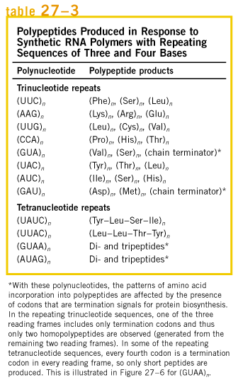
Three different
homopolypeptides were
produced from most
polyribonucleotides
consisting of repeating
sequences of three
nucleotides;
One type of polypeptide
containing repeating
tetrapeptides was always
produced from
polyribonucleotides
consisting of repeating
sequences of four
nucleotides.

Slide 25
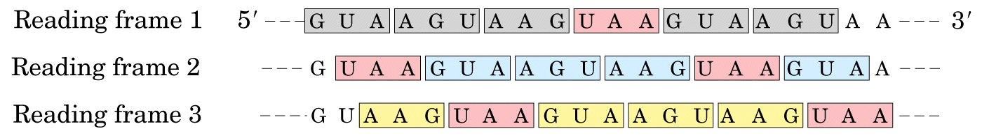
Effect of a termination codon in a
repeating tetranucleotide

Slide 26
8. All 64 triplet codes were deciphered by 1966
61 of the 64 codons code for the 20 amino acids and three (UAA, UAG, UGA) for chain termination, called termination codons, stop codons, or nonsense codons).
AUG is a dual codon coding for initiation and Met.
18 of the amino acids are coded by more than one codon: the genetic codes are degenerate.

Slide 27
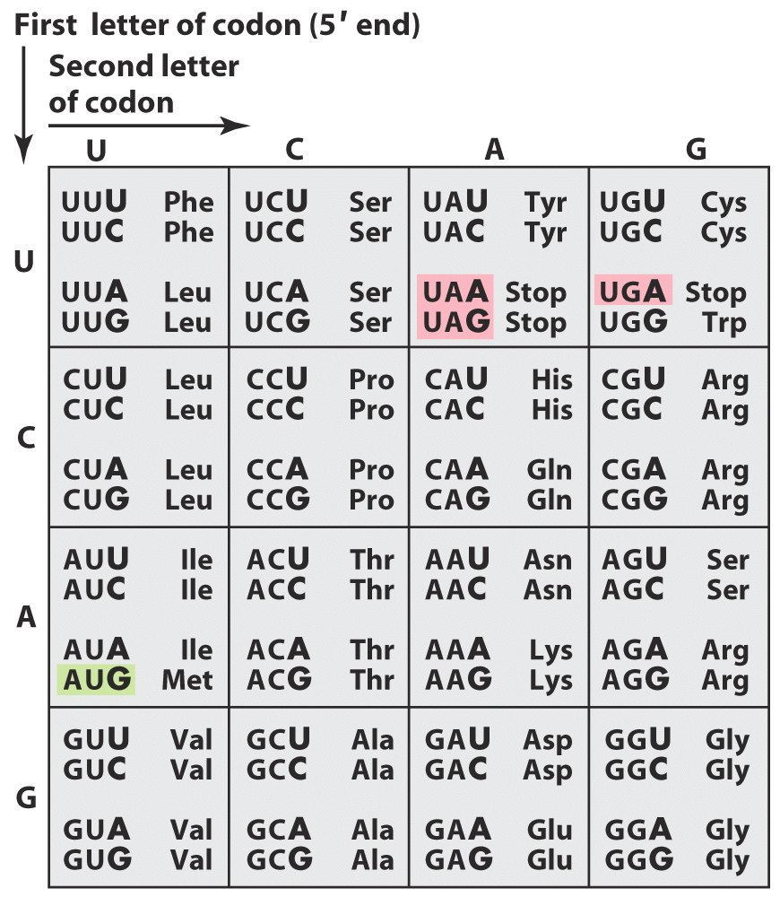
The genetic code

Slide 28
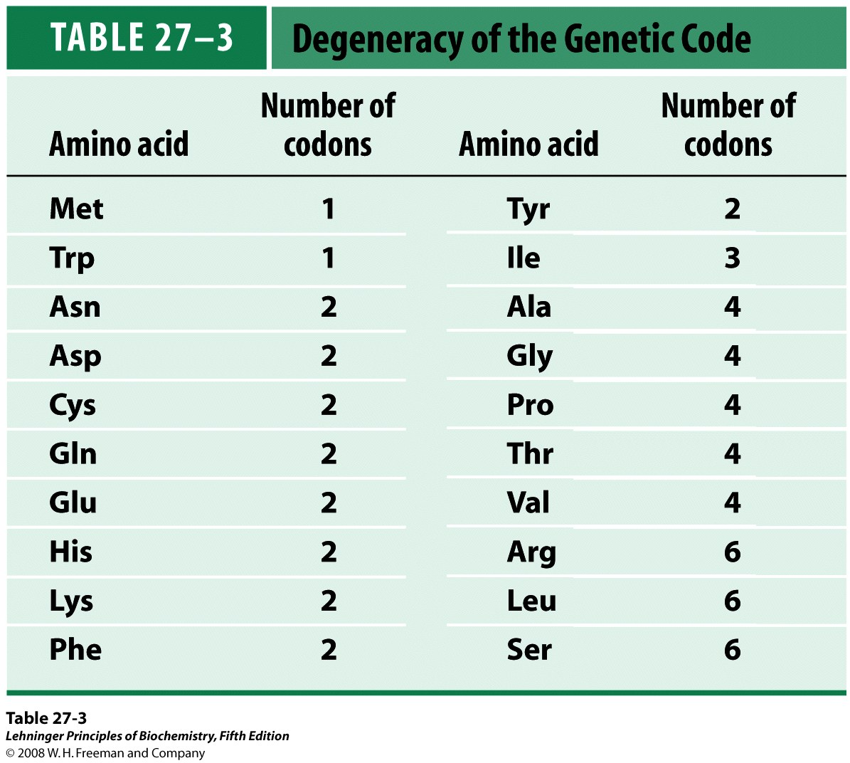
Notes:
TABLE 27-3 Degeneracy of the Genetic Code

Slide 29
The codes seem to have evolved in such a way to minimize the deleterious effects of mutations, especially at the third bases: XYU and XYC always encode the same amino acid; XYA and XYG usually code for the same amino acid.
A reading frame of more than 50 amino acids without a stop codon is called an open reading frame (ORF), which has the potential of encoding a protein.

Slide 30
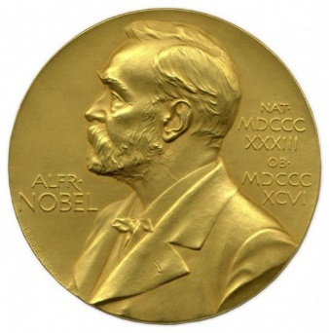


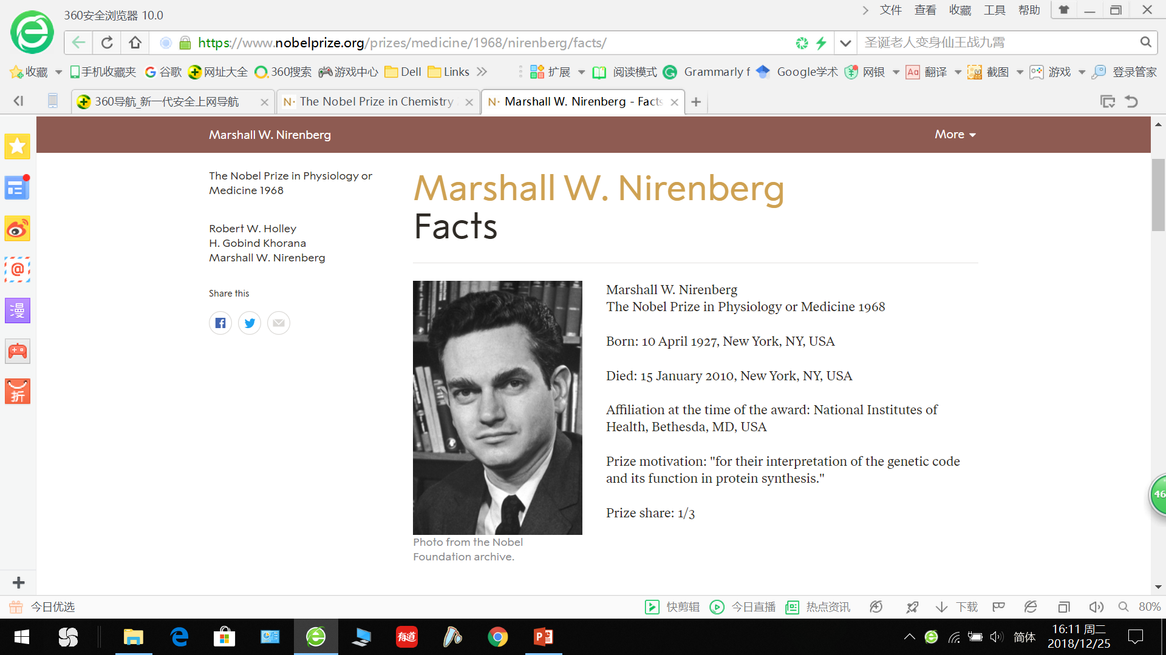
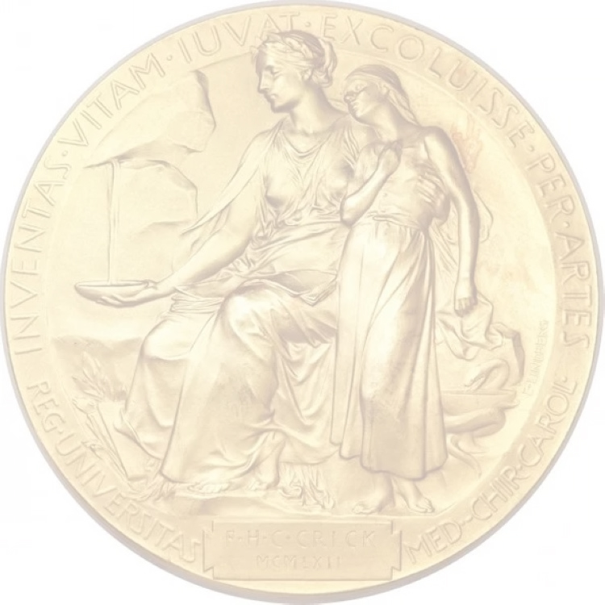
The Nobel Prize in Physiology or Medicine 1968
“for their interpretation of the genetic code and its function in protein synthesis”
Robert W. Holley
USA
Cornell University,
Ithaca, NY, USA
1922-1993
Har Gobind Khorana
India
University of Wisconsin,
Madison, WI, USA
1922-2011
Marshall W. Nirenberg
USA
National Institutes of Health, Bethesda, MD, USA
1927-2010
Established the chemical structure of tRNA
Devised methods to
synthesize RNAs with
defined sequences
Established the in vitro system for revealing the
genetic codes

Slide 31
9. The genetic code has been proved to be nearly (but not absolutely) universal
Direct comparisons of the amino acid sequences of proteins with the corresponding base sequence of their genes or mRNAs, as well as recombinant DNA technologies, proved that the genetic codes deciphered from in vitro studies were correct and almost universally applicable.
A small number of “unusual codes” have been revealed in many mitochondria genomes and nuclear genome of a few organisms.

Slide 32
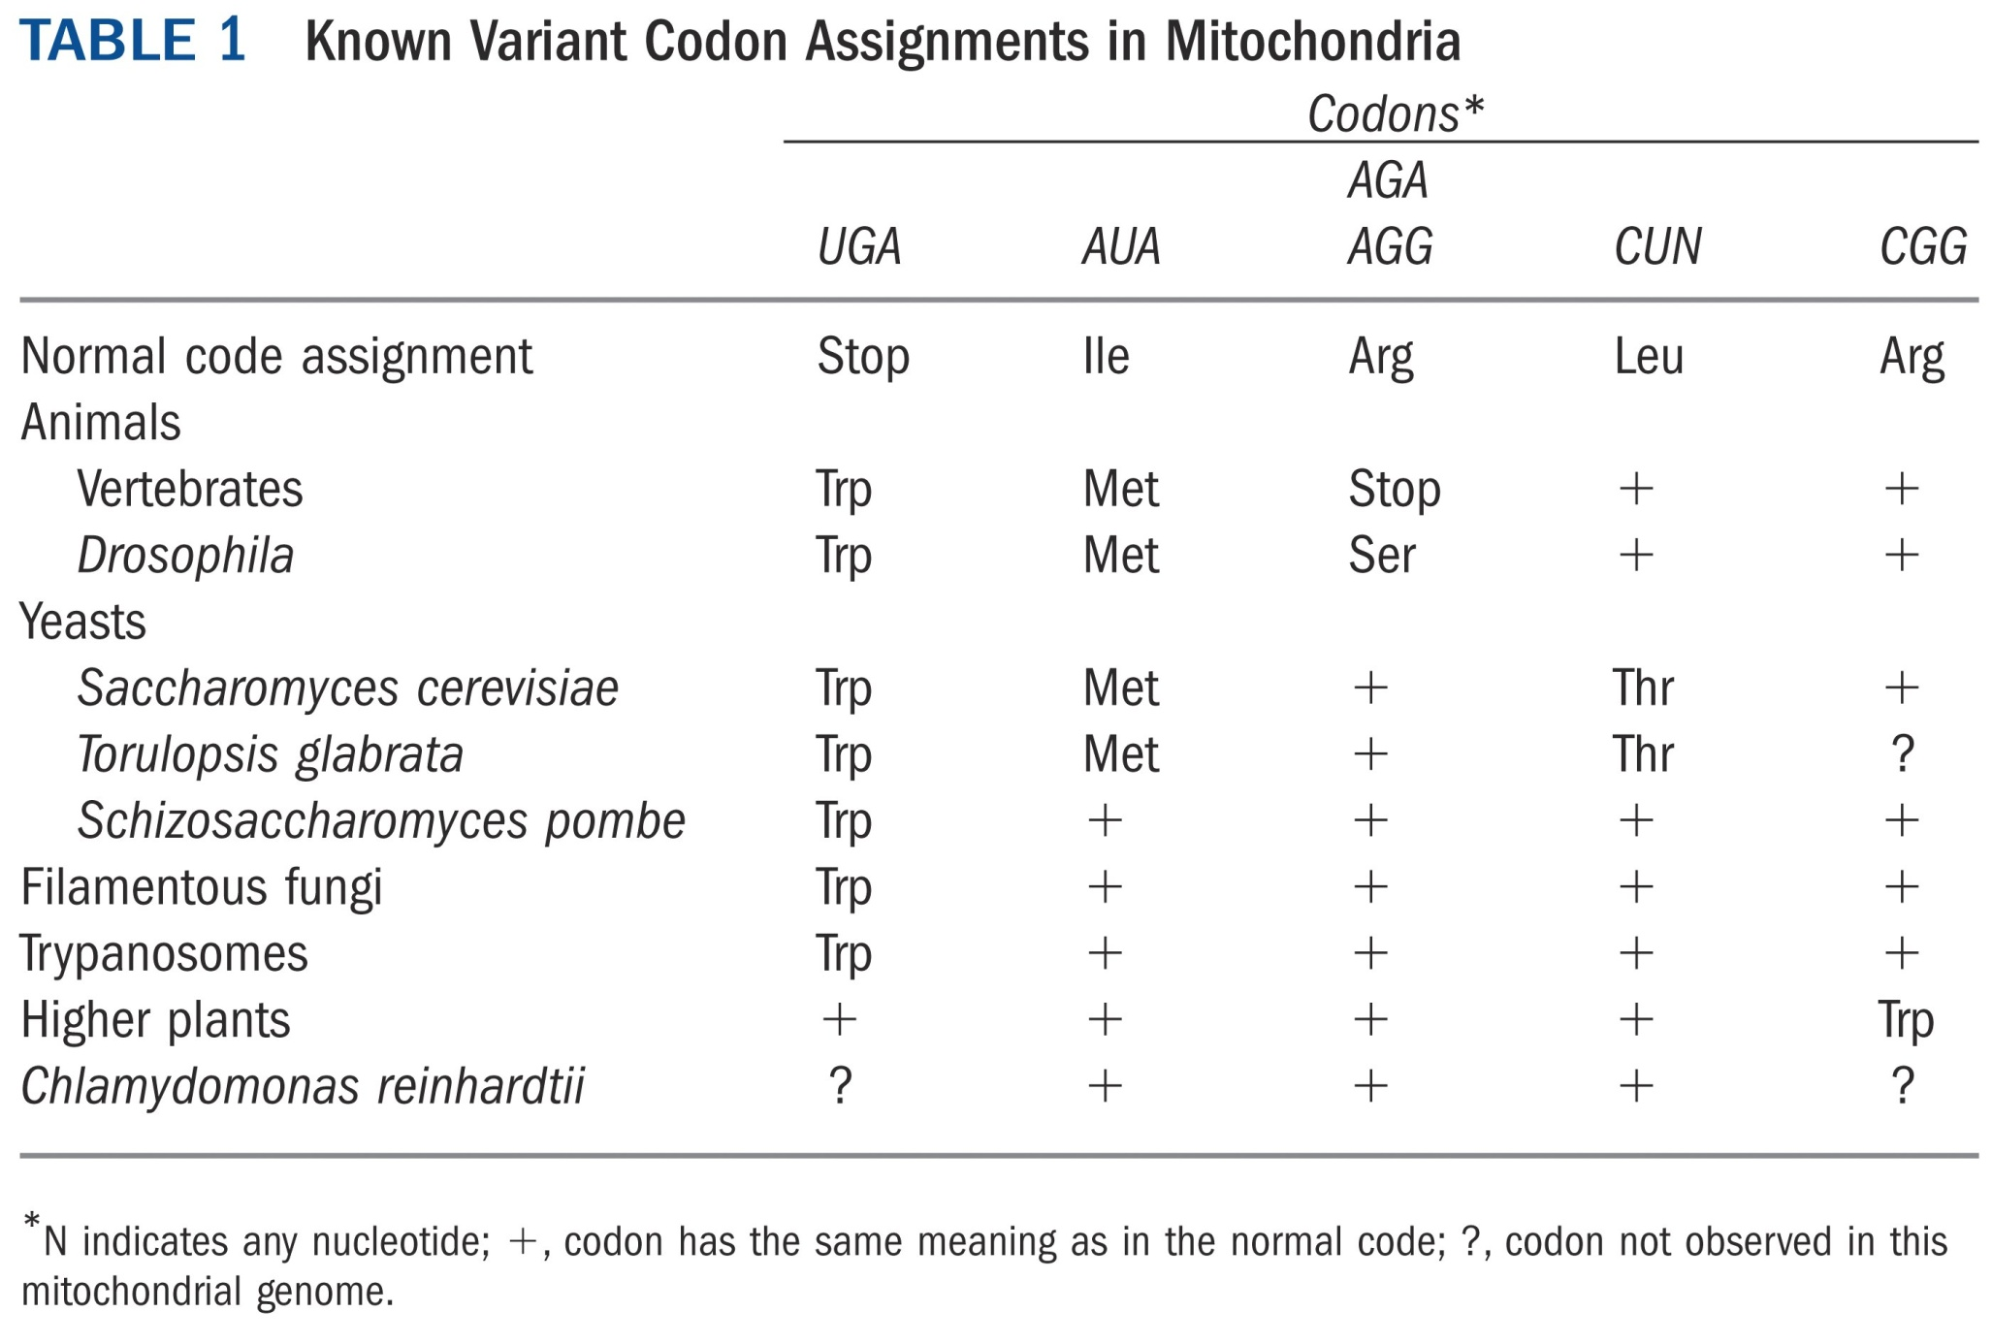

Slide 33
10. Overlapping genes were found in some viral DNAs
Genes usually do not overlap.
The 5.3 kb DNA of bacteriophage φX174 was found to be not long enough to code for the ten proteins it produces.
Detailed sequence correlation of the viral DNA and the protein sequences revealed the “gene within genes” phenomena.
The overlapping genes use different reading frames.
This phenomena was also found in other viruses (including λ phage, SV40).

Slide 34
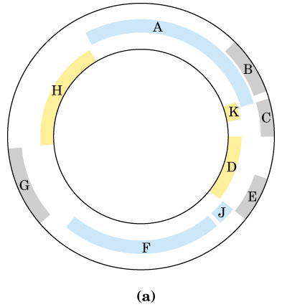
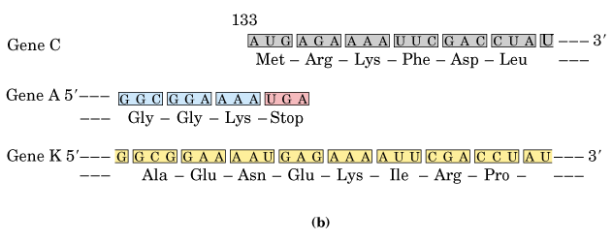
Some genes
overlap in the
φX174
bacteriophage
DNA

Slide 35
11. Three kinds of RNA molecules perform different but cooperative functions in protein synthesis
mRNAs carry the genetic information copied from DNA in the form of genetic codons.
tRNAs mediate the incorporation of specific amino acids according to genetic codons present on the mRNA molecules via their specific anticodon triplets.
rRNAs associate with a set of proteins to form the protein-synthesizing machines (ribosomes) and probably catalyze peptide bond formation during protein synthesis.

Slide 36
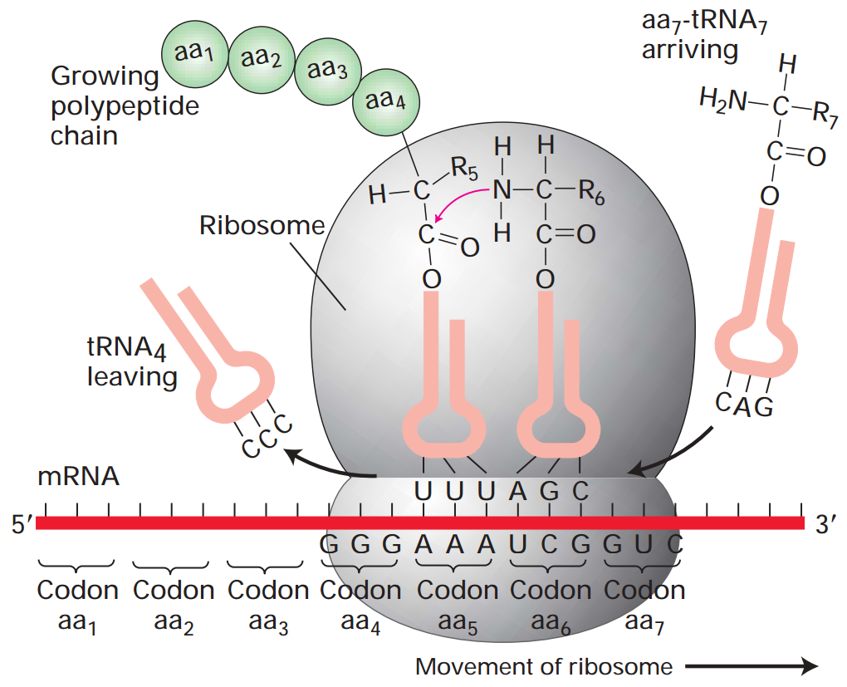
Roles of the three types of RNA in translation

Slide 37
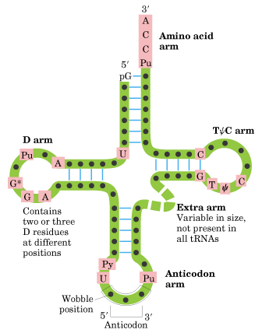
Site for amino acid
attachment
ribothymidine
5, 6-dihydrouridine
pseudouridine
All tRNAs have common structural features:
cloverleaf in secondary, “L” in 3-D structure.

Slide 38
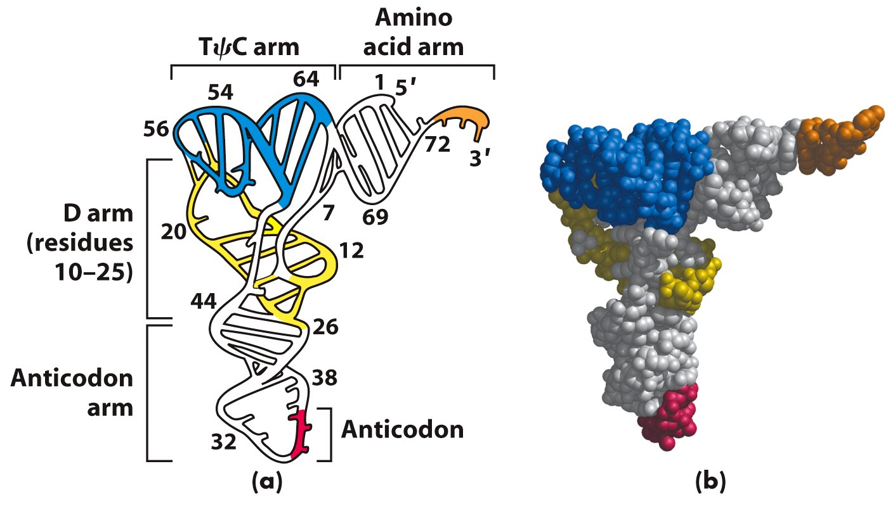
Three-dimensional structure of yeast tRNA^{Phe}
deduced from x-ray diffraction analysis

Slide 39
12. Some tRNA molecules can recognize more than one codon via wobble pairing
The adaptor tRNAs recognize the codons on a mRNA via a triplet called anticodon.
It was first proposed that a specific tRNA anticodon would exist for every of the 61 (or 64) codons, but less tRNAs were revealed.
It was revealed that highly purified tRNA molecules (e.g., alanyl-tRNA^{Ala}) of known sequence could recognize several different codons.
Inosinate (I, 次黄(嘌呤核)苷), which may form base pair with A, U, and C, was found to be present at the first position of the anticodons in some tRNAs.

Slide 40
Crick proposed the “wobble hypothesis” in 1966 to explain the pairing features between anticodons and codons:
The first two bases of a codon in mRNA confer most of the coding specificity, the third base can be loosely paired with the anticodons;
The first base of some anticodons can wobble and determines the number of codons a given tRNA can read (A and C for one, U and G for two, I for three);
Codons that specify the same amino acid but differ in either of the first two bases need different tRNAs, i.e., a minimum of 31 tRNA are needed to translate the 61 codons;

Slide 41
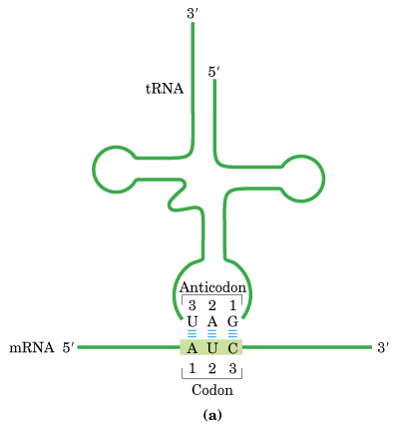
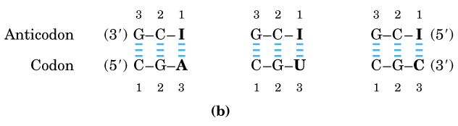
The codon-anticodon pairing between an mRNA and a tRNA: the presence of an inosinate residue at position one in the anticodon allows the tRNA to recognize a few codons.

Slide 42
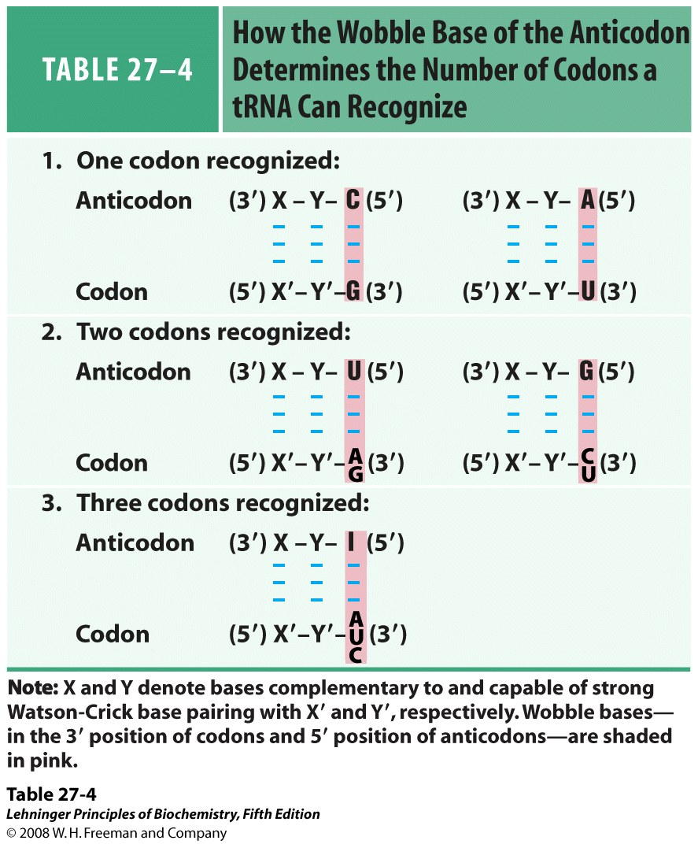
*****
Notes:
TABLE 27-4 How the Wobble Base of the Anticodon Determines the Number of Codons a tRNA Can Recognize

Slide 43
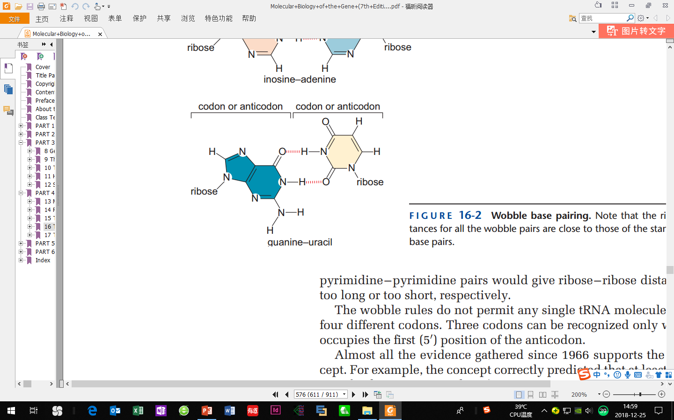
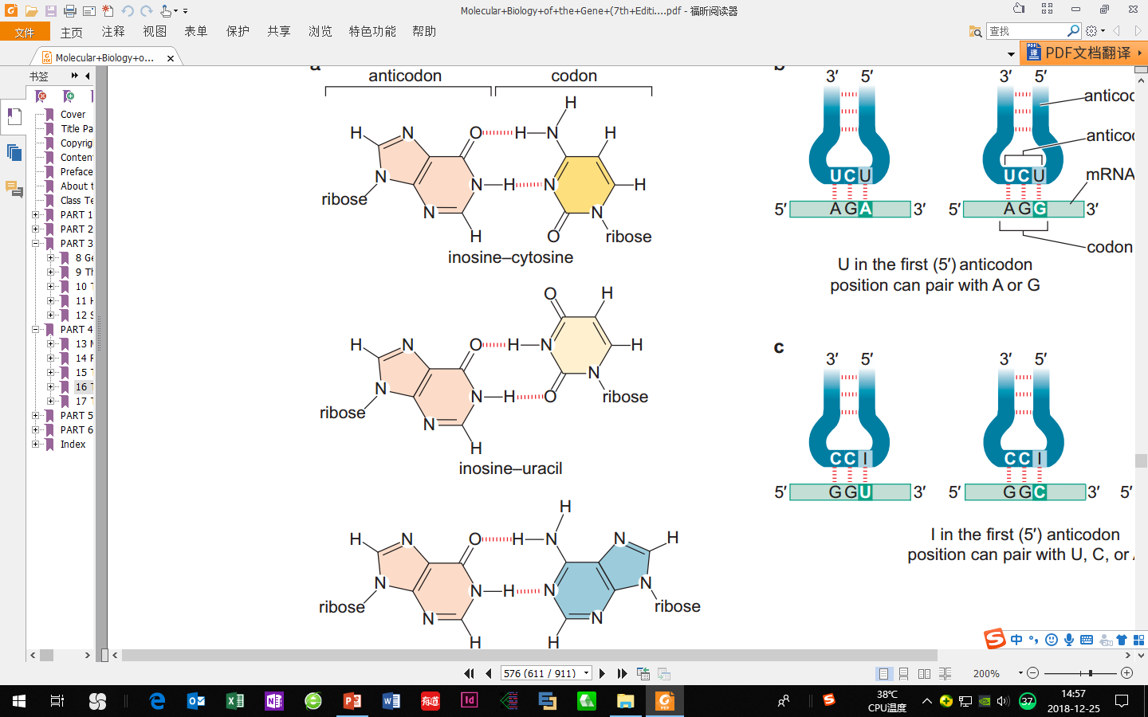
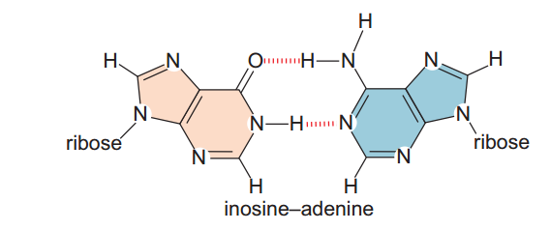
U
I
C
G
U
guanine-uracil
I
Possible wobble pairing between anticodon and codon.
I
A

Slide 44
This hypothesis has been widely supported by all the evidence gathered since (thus the “wobble rule”).
This moderate pairing strength may serve to optimize both the accuracy and speed of polypeptide synthesis.

Slide 45
13. Ribosomes are the protein-synthesizing machines
All ribosomes consist of two subunits of unequal size.
The total size of the prokaryotic and eukaryotic ribosomes are 70S (30S+50S) and 80S (40S+60S), respectively. The large unit contain two or three rRNA molecules and 31 or 50 proteins for prokaryotes and eukaryotes, respectively.
The small unit contain one rRNA molecule and 21 or 33 proteins for prokaryotes and eukaryotes, respectively.
The rRNA and protein components of the bacterial ribosomes have been separated and successfully reconstituted in vitro.

Slide 46
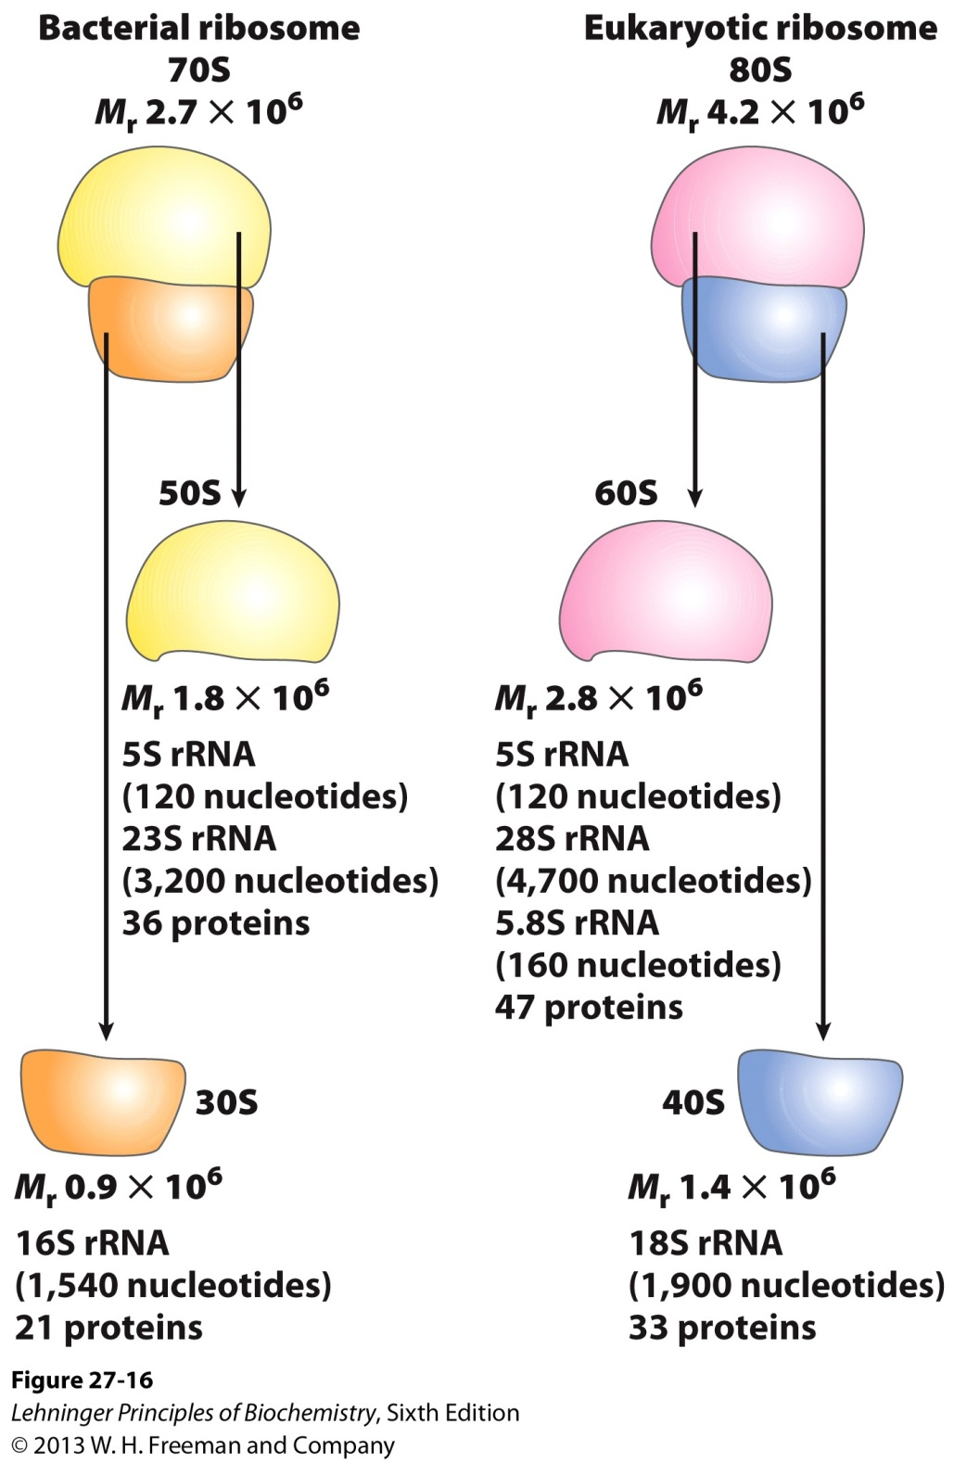
Summary of the
composition and mass
of ribosomes in
bacteria and eukaryotes

Slide 47
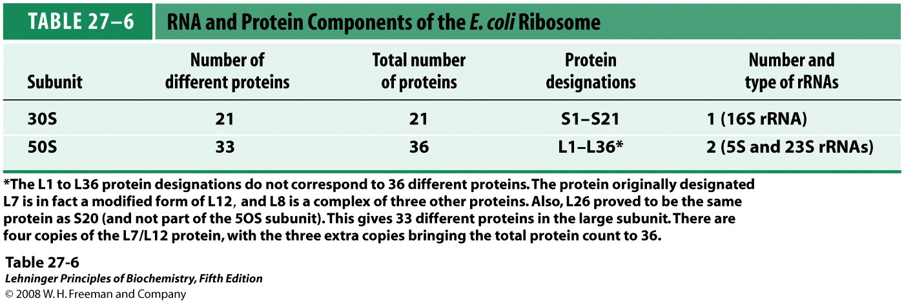
Notes:
TABLE 27-6 RNA and Protein Components of the E. coli Ribosome

Slide 48
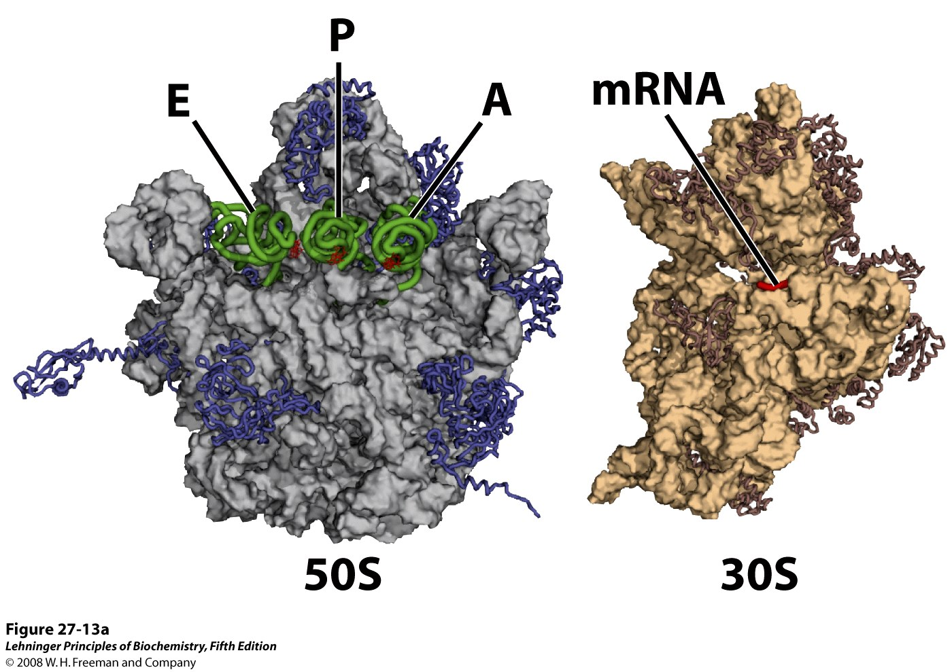
tRNA
The structure of ribosomes
Notes:
FIGURE 27-13a The bacterial ribosome. Our understanding of ribosome structure has been greatly enhanced by multiple high-resolution images of the bacterial ribosome and its subunits, contributed by several research groups. A sampling is presented here. (a) The 50S and 30S bacterial subunits, split apart to visualize the surfaces that interact in the active ribosome. The structure on the left is the 50S subunit (derived from PDB ID 2OW8, 1VSA, and 1GIX), with tRNAs (displayed as green backbone structures) bound to sites E, P, and A, described later in the text; the tRNA anticodons are in red. Proteins appear as blue wormlike structures representing the peptide backbone; the rRNA as a gray rendering of the surface features. The structure on the right is the 30S subunit (derived from PDB ID 2OW8). Protein backbones are brown wormlike structures and the rRNA is a lighter tan surface rendering. The part of the mRNA that interacts with the tRNA anticodons is shown in red. The rest of the mRNA (not shown) winds through grooves or channels on the 30S subunit surface.

Slide 49
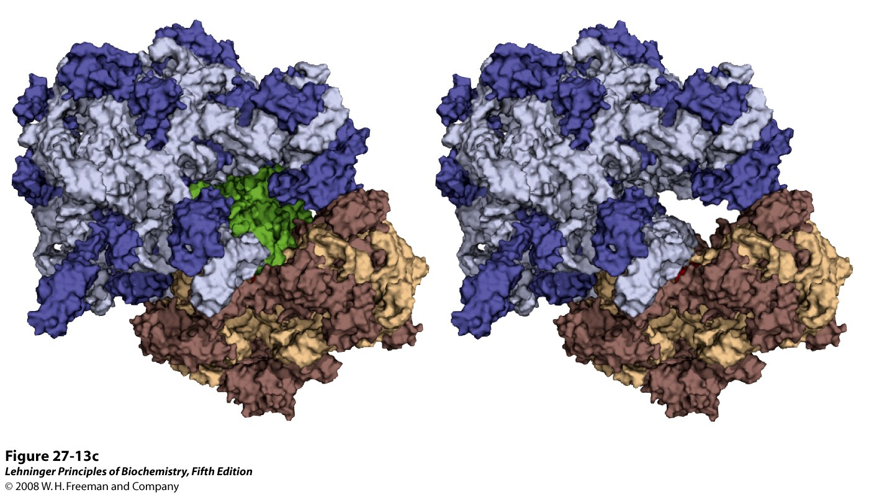
The assembled ribosome
Notes:
FIGURE 27-13c The bacterial ribosome. (c) A pair of ribosome images in the same orientation as in (b), but with all components shown as surface renderings to emphasize the mass of the entire structure. In the structure on the right, the tRNAs have been omitted to give a better sense of the cleft where protein synthesis occurs.

Slide 50
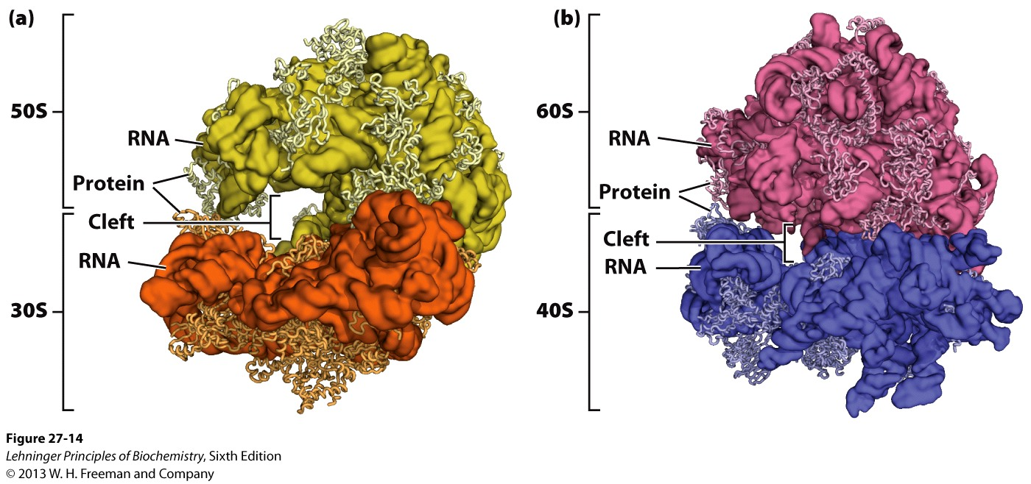
The structure of ribosomes

Slide 51
14. Pulse-labeling (isotope tracer) studies revealed that polypeptide synthesis begins at the N-terminal
³H-leucine was added to reticulocyte cells actively synthesizing hemoglobin for a short period of time.
α and β chains of hemoglobin were isolated, treated with trypsin and analyzed by fingerprinting and autoradiography.
A gradient of radioactivity increasing from the amino to carboxyl end of each chain was detected, indicating that the carboxyl end was synthesized last: the polypeptide chain grows by successive addition of amino acids at the C-terminal.

Slide 52
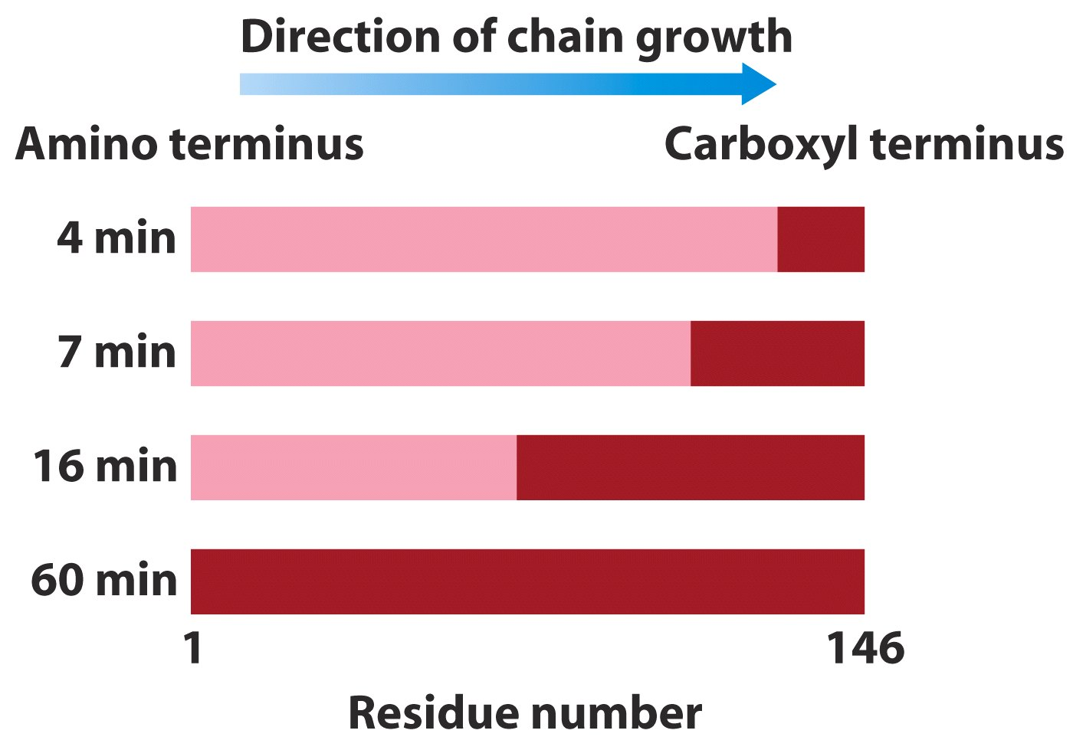
Pulse-labeling (isotope tracer) studies revealed that
polypeptide synthesis begins at the N-terminal.

Slide 53
15. mRNA is efficiently translated by polysomes in the 5’ 3’ direction
When the synthetic polynucleotide AAA(AAA)_{n}AAC was used as templates to guide polypeptide synthesis in a cell-free protein-synthesizing system, the polypeptide Lys-(Lys)_{n}-Asn was produced.
Translation undergoes from 5’ 3’ along the mRNA.
EM studies showed that multiple ribosomes (as polysomes) can translate one single mRNA simultaneously in all cells.

Slide 54
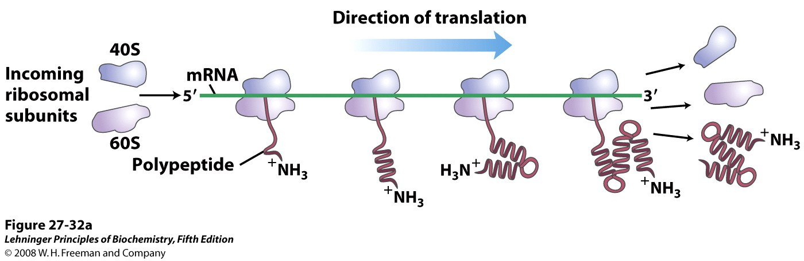
Multiple ribosomes (as polysomes) translate
one single mRNA simultaneously in all cells.

Slide 55
16. The synthesis of a protein can be divided into five stages
Each amino acid is first covalently attached to a specific tRNA molecule in a reaction catalyzed by a specific aminoacyl-tRNA synthetase (Stage 1).
The mRNA then binds to the smaller subunit of the ribosome, after which the initiating aminoacyl-tRNA and the large subunits of the ribosome will bind in turn to form the initiating complex (Stage 2).

Slide 56
The first peptide bond is then formed after the second aminoacyl-tRNA is recruited with help of the elongation factors, and the chain is then further elongated (Stage 3).
When a stop codon (UAA, UAG, and UGA) is met, the extension of the polypeptide chain will come to a stop and is released from the ribosome with the help from release factors (Stage 4).
The newly synthesized polypeptide chain has to be folded and modified (in many cases) before becoming a functional protein (Stage 5).

Slide 57
17. The 20 aminoacyl-tRNA synthetases attach the 20 amino acids to one or more specific tRNAs
An amino acid is first activated to form an aminoacyl-AMP intermediate (can be isolated when tRNA is absent), and is then charged to one or more specific tRNAs, all catalyzed by one such specific aminoacyl-tRNA synthetase.
The 20 synthetases have diverse sizes, subunit composition, and amino acid sequences and are categorized into two classes: class I and II, which bind to opposite faces of the incoming tRNAs, link the amino acids to the 2’-OH or the 3’-OH groups of the terminal adenosine respectively.

Slide 58
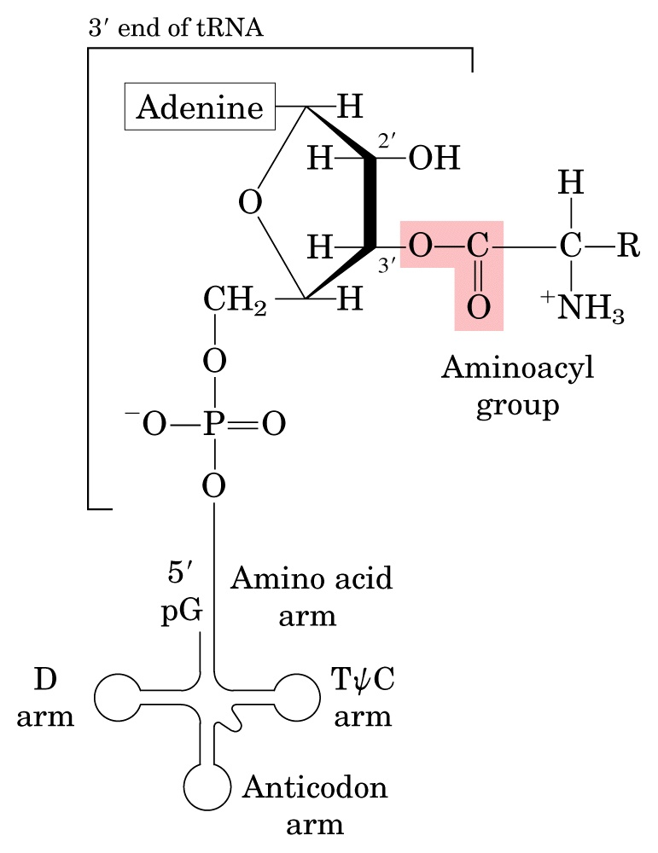
Stage 1
Each amino acid is
specifically attached
to a specific tRNA
before being used for
protein synthesis.

Slide 59
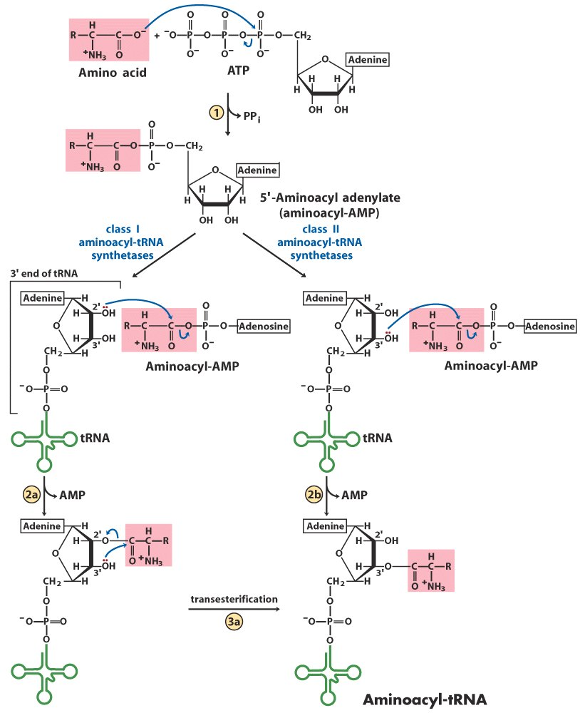
Aminoacyl-tRNA synthetases
can be divided into two classes
based on differences in structure and reaction mechanisms.

Slide 60
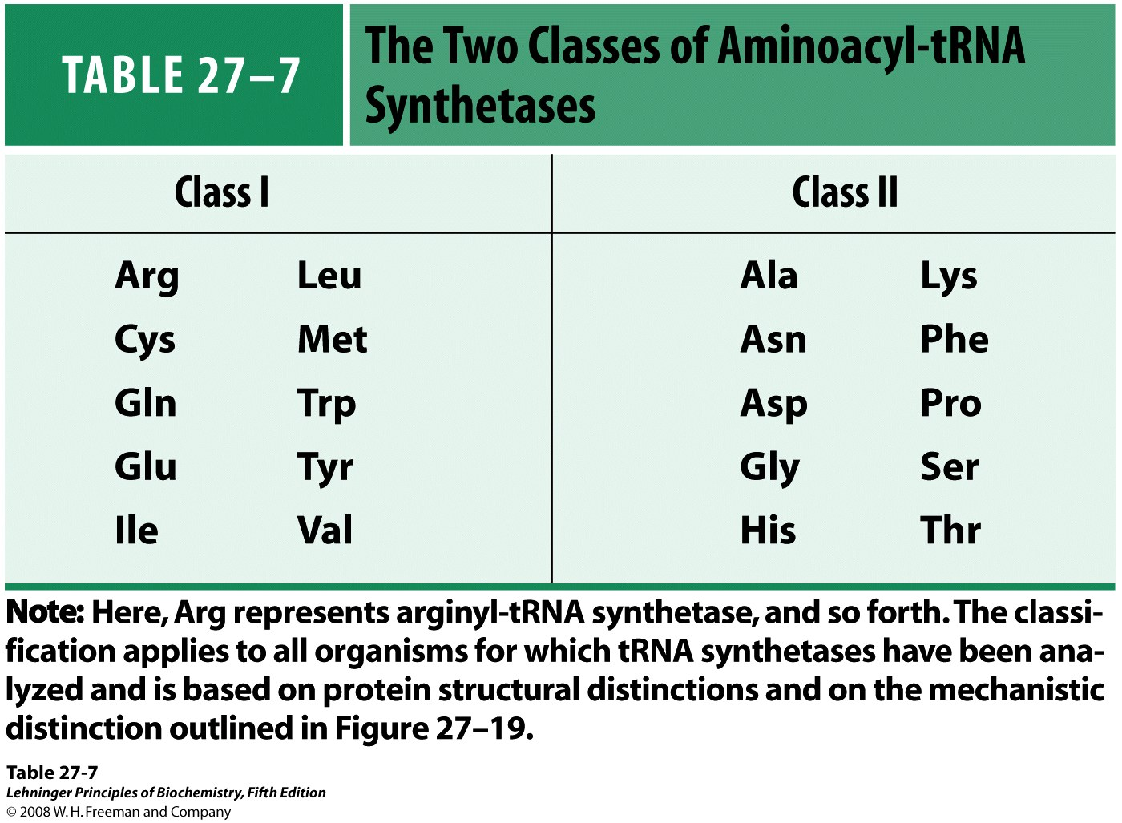
Notes:
TABLE 27-7 The Two Classes of Aminoacyl-tRNA Synthetases

Slide 61
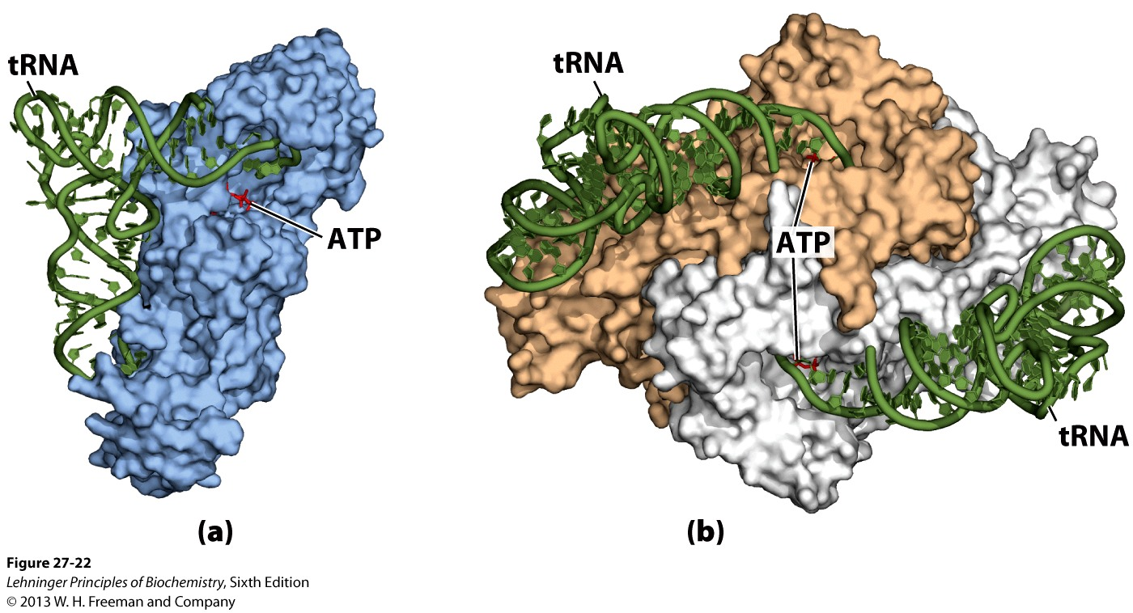
Gln-tRNA synthetase
(type I, monomeric)
Asp-tRNA synthetase
(type II, dimeric)

Slide 62
18. The anticodon and/or the amino acid arms of a tRNA are the key for a specific aminoacyl-tRNA synthetase to recognize
This was revealed via: crystal structure determination of the synthetases complexed with their cognate tRNAs; sequence comparison of tRNAs binding to the same synthetase; and mutagenesis studies.
When the anticodon of tRNA^{Val} is changed from UAC to CAU, the mutated tRNA^{Val} can be recognized by Met-tRNA synthetase and generates a Met-tRNA^{Val}.

Slide 63
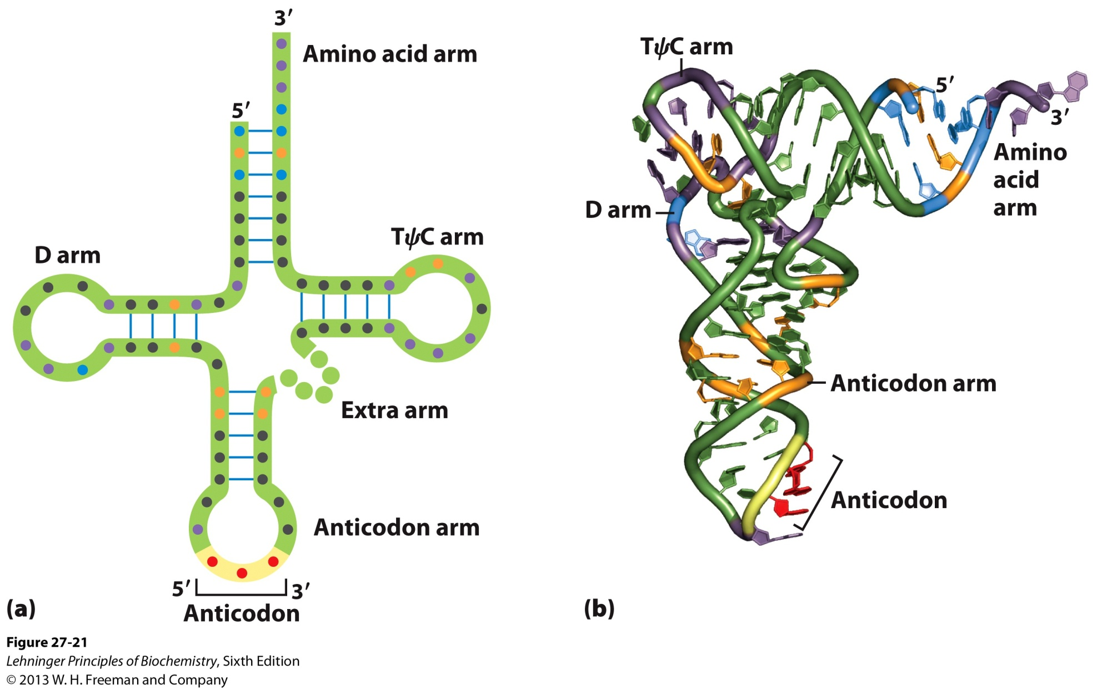
Positions (blue and orange) of nucleotides
are involved in recognition between
tRNAs and aminoacyl-tRNA synthetases.

Slide 64
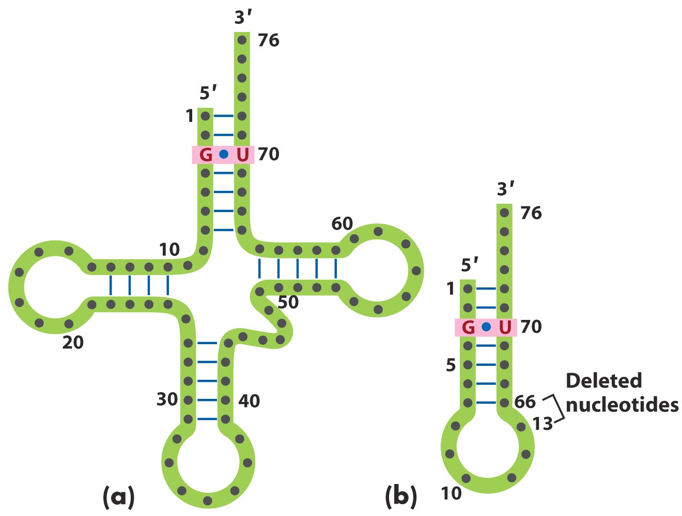
A single G=U base pair is the only
element needed for specific binding
of tRNA^{Ala} and aminoacylation by
Ala-tRNA synthetase.

Slide 65
When the 3:70 base pair on the amino acid arm of tRNA^{Cys} is changed from C.G to G.U, the mutated tRNA^{Cys} is able to carry Ala, instead of Cys.
A “microhelix” containing only 24 of the 76 nucleotides of tRNA^{Ala} is recognized and aminoacylated by Ala-tRNA synthetase.

Slide 66
19. Proofreading by some aminoacyl-tRNA synthetases increases the fidelity of protein synthesis
The identity of the amino acid attached to a specific tRNA is not checked by the ribosome (Ala-tRNA^{Cys} experiment).
The calculated rate of incorrect incorporation of Val in place of Ile is 1 in 200, but the observed rate is only 1 in 3000.
Some synthetases are able to proofread the incorrectly incorporated similar amino acids (e.g., between Val and Ile) at the aminoacyl-AMP stage or the aminoacyl-tRNA stage.

Slide 67
There seems to be separate proofreading active site(s) on such synthetases.
In a few synthetases that activate amino acids having no close structural relatives, no such proofreading activities have yet been identified (selected at the substrate binding level).

Slide 68
20. Met-tRNA_{i}^{Met} recognizes the initiating AUG codon in almost all cells
It was observed that about half of the N-terminal residues of proteins in E.coli are Met, and the N-terminal of nascent polypeptides is usually modified.
There are two tRNAs for recognizing AUG and Met in all organisms: one (tRNA_{i}^{Met}) brings Met to the initiating AUG and the other (tRNA^{Met}) brings Met to internal AUGs.
The Met charged on tRNA_{i}^{Met} (by Met-tRNA synthetase) is specifically formylated by a transformylase to form fMet-tRNA^{fMet} in bacteria (Met-tRNA^{Met} can not be formylated).
fMet-tRNA^{fMet} can only enter and only fMet-tRNA^{fMet} can enter the initiation site (site P) on the ribosome in E.coli.

Slide 69
Two types of methionine tRNA (tRNA_{i}^{Met}
or tRNA^{fMet} in bacteria, and tRNA^{Met})
are found in all cells.
Both tRNAs are recognized by the same
Met-tRNA synthetase.

Slide 70
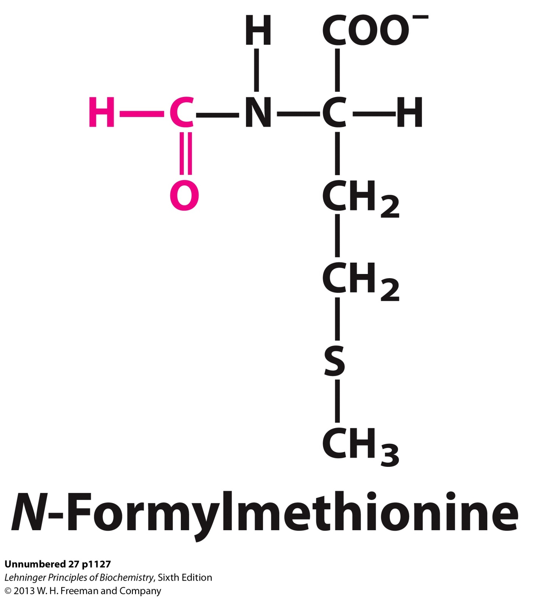

Slide 71
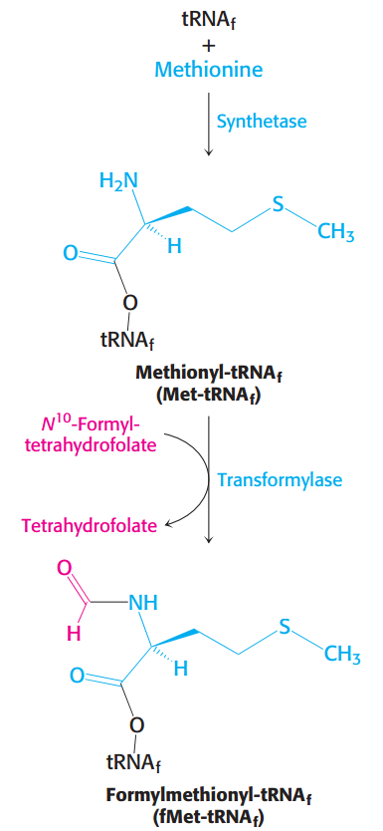
The Met charged on tRNA^{fMet}
(by Met-tRNA synthetase) is
specifically formylated by
the action of transformylase
to form fMet-tRNA^{fMet}
in bacteria;
N¹⁰-Formyltetrahydrofolate
provides the formyl group.

Slide 72
21. The Shine-Dalgarno sequence and a nearby AUG marks the start site of translation on a bacterial mRNA
Sequence comparison of the initiator region of all bacterial mRNAs revealed that a purine-rich sequence called Shine-Dalgarno sequence is located about 10 nucleotides upstream the initiating AUG (or rarely GUG in bacteria) codon.
This purine-rich sequence was found to be complementary to a pyrimidine-rich sequence at the 3’ end of the 16S rRNA present in the 30S subunit of the ribosomes.
The Shine-Dalgarno sequence may thus serve as the ribosome binding site on bacterial mRNAs.

Slide 73
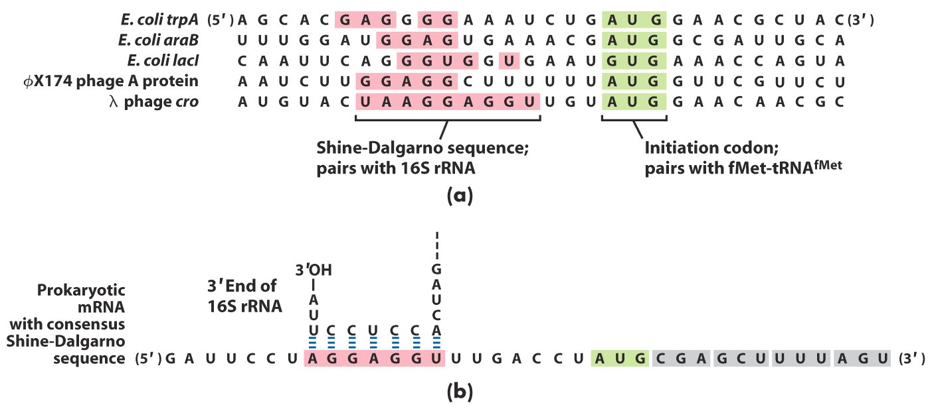
A purine-rich Shine-Dalgarno sequence and a AUG
codon mark the start site of polypeptide synthesis
on bacterial mRNA molecules.

Slide 74
22. Aided by initiation factors, the mRNA, the fMet-tRNA^{fMet} and the ribosome assemble to form an initiation complex
The 16S rRNA directs the 30S subunit of ribosome to the initiation site of the mRNA (through base pairing).
IF3 binds to the 30S subunit to prevent its premature association with the 50S subunit.
IF2 (with GTP bound) then helps the fMet-tRNA^{fMet} to enter the P (peptidyl) site on the 30S subunit where the initiation codon is located (no other aminoacyl-tRNA can enter the P site!).
The joining of the 50S subunit releases all the initiation factors and forms the initiation complex.

Slide 75
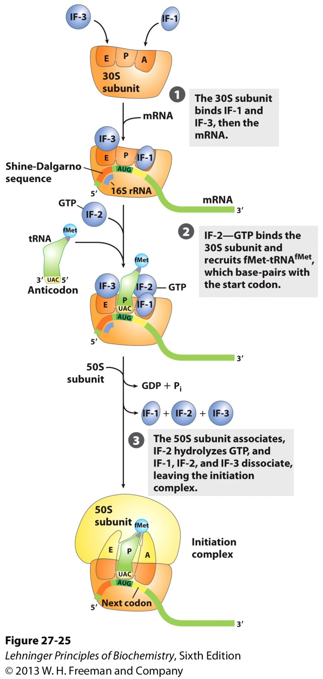
Stage 2
The initiating complex is assembled
from the small subunit of the
ribosome, the mRNA, the initiating
aminoacyl-tRNA (being
fMet-tRNA^{fMet} in bacteria), and the
large subunit of the ribosome.

Slide 76
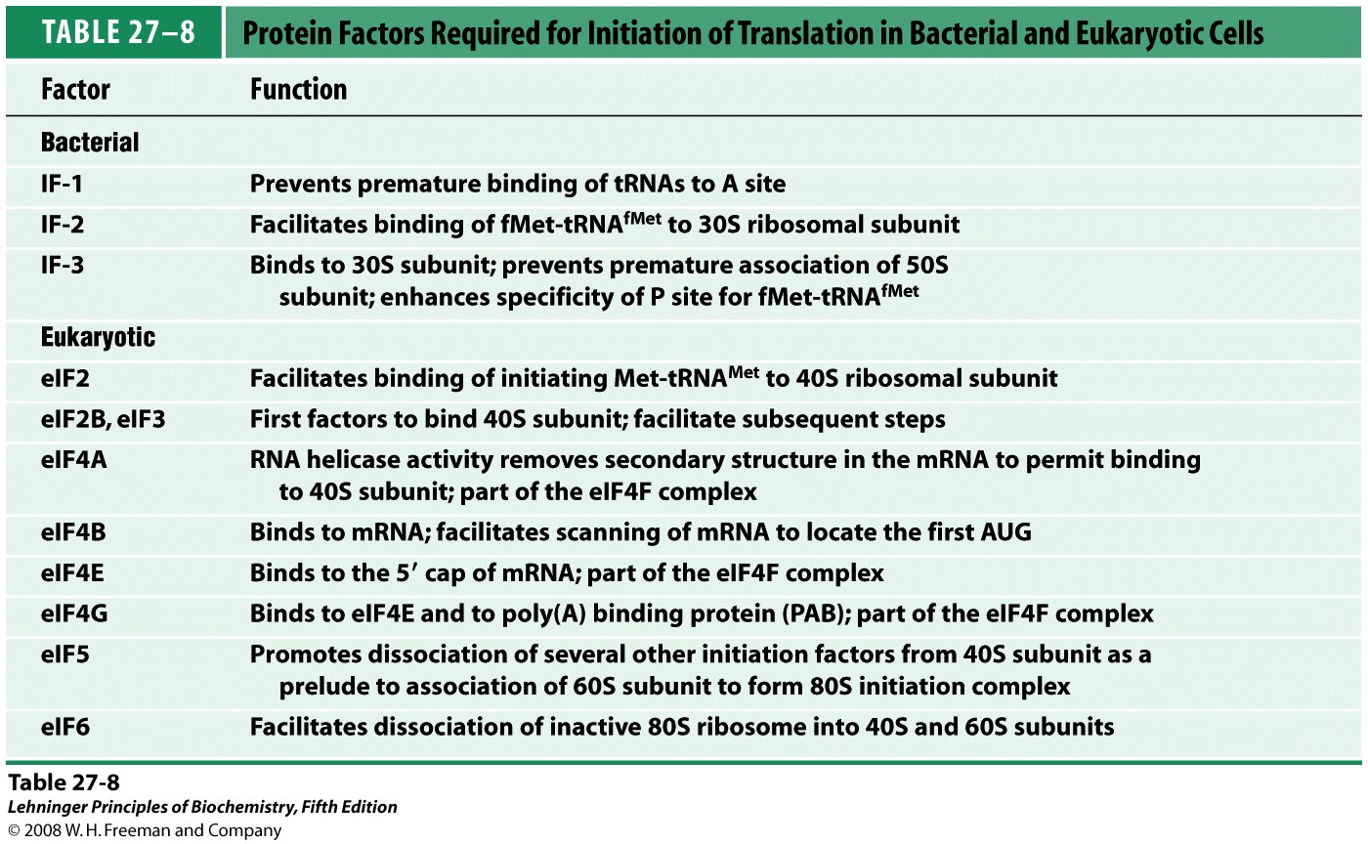
*****
Notes:
TABLE 27-8 Protein Factors Required for Initiation of Translation in Bacterial and Eukaryotic Cells

Slide 77
23. The polypeptide chain is elongated via a repeating three-step reactions
The next aminoacyl-tRNA is delivered to the A (aminoacyl) site of the ribosome by EF-Tu-GTP (step 1).
EF-Tu (being about 5% of the total bacterial protein) is believed to protect the activated ester bond from being hydrolyzed by water.
The milliseconds taken for GTP hydrolysis on EF-Tu and milliseconds for EF-Tu-GDP to leave is believed to allow the anticodon-codon interaction to be proofread.
The fMet group is transferred to the second aminoacyl-tRNA in the A site to form a peptide bond, generating a dipeptidyl-tRNA (step 2).

Slide 78

Stage 3
Step 1:
Aminoacyl-
tRNA enters
the A site
(EF-Tu)
1st elongation step in bacteria: binding of the second aminoacyl-tRNA

Slide 79

Stage 3
Step 2: Peptide bond formation
(23S rRNA)
2nd elongation step in bacteria: formation of the first peptide bond

Slide 80

Stage 3
Step 3:
Translocation
(EF-G)
3rd elongation step in bacteria: translocation

Slide 81
The 23S rRNA of the large subunit of the ribosome seems to have the peptidyl transferase activity, thus being a ribozyme (Noller, 1992).
EF-G (the translocase) then promotes the translocation of the ribosome along the mRNA by the distance of one codon: the deacylated tRNA^{fMet} is released from the E (exit) site of the ribosome, the dipeptidyl-tRNA is relocated to the P site, and the A site is open for the incoming (the third) aminoacyl-tRNA (step 3).

Slide 82
24. Polypeptide synthesis is terminated by release factors that read the stop codons
Two bacterial protein factors called RF-1 and RF-2 recognize the stop codons (RF-1 for UAA and UAG; RF-2 for UAA and UGA).
A third releasing factor RF-3 is a GTP-binding protein and seems to act in concert to promote the cleavage of the peptide from peptidyl-tRNA.
The specificity of the peptidyl transferase (23S rRNA) is altered by the release factor: water become the acceptor of the activated peptidyl moiety.
A single eukaryotic release factor called eRF recognizes all three stop codons.

Slide 83

Stage 4
The polypeptide chain is
released from the ribosome
when meeting a stop
codon (UAA, UGA, or UGA).

Slide 84

An overview of the five stages of protein synthesis

Slide 85

*****
Notes:
TABLE 27-5 Components Required for the Five Major Stages of Protein Synthesis in E. coli

Slide 86
25. At least four high-energy bonds are ultimately consumed for the formation of each specific peptide bond
Two for activating each amino acid (ATP AMP + 2P_{i}).
One for EF-Tu to deliver the aminoacyl-tRNA to the A site of the ribosome (GTP GDP + P_{i}).
One for EF-G to translocate the ribosome after each peptide bond is formed (GTP GDP + P_{i}).
The net free energy change ( ΔG) in forming each peptide bond between specific amino acids is about
-100 kJ/mol.
This high energy consumption resulted in the nearly perfect fidelity in translation.

Slide 87
26. Each mRNA is usually translated simultaneously by many ribosomes (as polysomes)
This is observed in both prokaryotic and eukaryotic cells.
The guiding effectiveness of the short-lived mRNA molecules is thus dramatically increased.
In bacteria, the translation and transcription processes are tightly coupled!

Slide 88


Polysomes are
regularly seen
in cells.

Slide 89

In bacteria, translation
and transcription are
tightly coupled.
Coupling of transcription
and translation in bacteria

Slide 90
27. Protein synthesis is inhibited by many antibiotics and toxins
Puromycin (嘌呤霉素) causes premature termination of polypeptide synthesis by mimicking aminoacyl tRNA: it is able to enter the A site and accept the peptidyl group to form peptidyl puromycin, which however will dissociate from the ribosome (in both prokaryotes and eukaryotes).
The concept of A and P sites arose from the use of puromycin to ascertain the location of peptidyl-tRNA: when peptidyl-tRNA is anchored in the A site of the 30S subunit it can not react with puromycin.

Slide 91

Puromycin binds to site A
of ribosome, accepts the
peptidyl group and then
leaves the ribosome.
Disruption of peptide bond
formation by puromycin

Slide 92
Tetracyclin (四环素) blocks the site A of bacterial ribosomes.
Chloramphenicol (氯霉素) inhibits the peptidyl transferase activity of the 50S ribosomal subunit by binding to the loop in 23S rRNA that interacts with the CCA sequence of tRNA.
Streptomycin (链霉素) causes misreading of genetic codes at low concentrations and blocks fMet-tRNA^{fMet} to enter the P site at high concentrations (probably acts on the 16S rRNA).

Slide 93
Cycloheximide (放线菌酮) inhibits the peptidyl transferase activity of the 60S ribosomal subunit (eukaryotes).
Diphtheria toxin (白喉毒素) catalyzes the ADP-ribosylation of a modified His residue on eEF2, blocking the translocation of the peptidyl-tRNA from site A to site P.
Ricin (蓖麻蛋白) inactivates the 60S subunit of eukaryotic ribosomes.

Slide 94
28. The newly synthesized polypeptide chains need to be folded, assembled, and processed to make a functional protein
Newly synthesized polypeptide chains will assume their native conformation spontaneously or with the help from other proteins (called molecular chaperones), with or without further posttranslational modifications.
The N-terminal formyl, fMet or Met may be removed enzymatically.
The N-terminal amino and C-terminal carboxyl groups may be modified (e.g., acetylated).

Slide 95
Signal sequences (usually 15 to 30 residues in length) at the N-terminal of some proteins will be removed by specific peptidases after the protein reached their cellular destinations (protein targeting).
Specific amino acids in a protein may be enzymatically modified posttranslationally by groups like phosphate, carboxylate or methylate.
Oligosaccharide groups are covalently attached to specific Asn, Thr, or Ser residues in some proteins (glycoproteins, often function extracellularly).

Slide 96
Isoprenyl groups, which help anchor some proteins in a membrane, may be added to some eukaryotic proteins via a thioester bond (e.g., G proteins, lamins, and the ras protein).
Addition of cofactors via covalent or noncovalent bonds.
Proteolytic cleavage of larger precursor proteins.
Formation of disulfide bonds.

Slide 97
29. Proteins synthesized from ribosomes have to be targeted to specific cellular destinations
The synthesis of all proteins begins on free ribosomes in the cytosol.
A newly synthesized protein in E.coli can stay in the cytosol, or be sent to the plasma membrane, the outer membrane, the space between them, or the extracellular medium.
A newly synthesized protein in eukaryotic cells may be targeted for secretion, integration into plasma membrane, inclusion into specific organelles (e.g., nucleus, mitochondria, chloroplasts, lysosomes, peroxisomes) or the cytosol.

Slide 98
30. The signal hypothesis for protein targeting was proposed and proved correct
In the first version of the “signal hypothesis”, Gunter Blobel postulated (in 1971) that proteins secreted out of the cell contain an intrinsic signal that governs them to and across membranes.
In the more general version of the “signal hypothesis”, he postulated (in 1980) that each protein carries in its structure the information needed to specify its proper location in the cell.
A range of signals that govern proteins to the different parts of the cell have now been identified.

Slide 99

Proteins are targeted to various cellular locations.

Slide 100

The Nobel Prize in Physiology or Medicine 1999
“for the discovery that proteins have intrinsic signals that govern their transport and localization in the cell”
Günter Blobel
USA
Rockefeller University
New York
NY, USA
1936-2018

Slide 101
31. Signal sequences were revealed for proteins targeting into the ER lumen
Most lysosomal, membrane and secretary proteins have a N-terminal signal sequence that directs them for translocation into the lumen of the ER.
These signal sequences ranging in length from 13 to 36 residues have the following features: a highly hydrophobic stretch of 10 to 15 residues forms the center of the signal; one or more positively charged amino acid residues precedes the hydrophobic patch; a small and neutral residue (being often Ala or Gly) is located at the N-terminal side of the cleavage site.

Slide 102

Proteins are translocated to the ER lumen via the guidance of their N-terminal signal sequences, which share three similar structural features.

Slide 103
32. Appropriate signal sequences and the signal recognition particles (SRPs) direct the ribosomes to the ER membrane
The signal sequence of a nascent polypeptide chain will be recognized by a SRP, a complex containing one RNA (called the 7SL-RNA) and six different proteins.
The binding of SRP will halt polypeptide chain elongation and direct the ribosome to ER membrane via specific SRP and ribosome receptors.
The nascent polypeptide chain is delivered to the peptide translocation complex on the ER membrane.
SRP then dissociates and chain elongation resumes.

Slide 104
The signal sequence is then cleaved by a specific peptidase in the ER lumen.
The ribosome dissociates from the ER membrane after the complete polypeptide chain is synthesized and translocated into the ER lumen.
The newly synthesized polypeptide chain is processed and folded in the ER lumen.

Slide 105

A signal sequence directs the translocation of a polypeptide
chain to and cross the ER membrane.

Slide 106
33. Glycosylation plays a key role in targeting certain proteins to lysosomes
A 14-residue core oligosaccharide is built up by sequential addition of monosaccharide units to a dolichol-phosphate, which occurs on the cytosolic and lumen surfaces of the ER membrane.
The core is then enzymatically transferred en bloc to the side chain of a specific Asn residue (in Asn-X-Ser/Thr) of a growing polypeptide chain inside the lumen of ER (cytosolic proteins are not glycosylated as a result).
Such glycosylated proteins and other proteins are transported from ER to Golgi complex.

Slide 107
O-linked oligosaccharides are added and N-linked ones are further modified in the Golgi complex, retaining a pentasaccharide core attached to Asn.
Proteins are finally sorted for various destinations on the basis of structural features: cell exterior, plasma membrane or lysosomes.
The presence of one or more mannose-6-P in the N-linked oligosaccharides targets the hydrolases specifically to lysosomes (Man is phosphorylated using UDP-GlcNAc).
Hydrolases would be secreted, instead of being targeted to lysosomes if cells are treated with tunicamycin, which blocks the first step of the formation of the N-linked oligosaccharides (glycosylation is essential for targeting proteins to lysosomes).

Slide 108

An UDP-GlcNAc analog
Synthesis of the core oligosaccharide of glycoproteins

Slide 109

Pathway taken by proteins destined for lysosomes, the plasma membranes, or secretion

Slide 110
34. Signals for targeting proteins to other cellular locations are being identified
Proteins targeted to mitochondria and chloroplasts have a uptake-targeting sequence at the N-terminal that will be cleaved once the proteins reached their final destinations.
Molecular chaperones are required for keeping proteins in a partially unfolded form in cytosol and for protein refolding in mitochondria and chloroplasts.
Proteins targeted to nucleus have an internal signal sequence that will not be cleaved after proteins reach the nucleus.
Proteins with a C-terminal KDEL are returned to the ER.

Slide 111


Proteins targeting to mitochondria and chloroplasts

Slide 112

Targeting of nuclear proteins

Slide 113
35. Bacteria also use signal sequences to target proteins
The signal sequences for targeting proteins to the inner and outer membranes, periplasmic space and extracellular medium are much like those found on eukaryotic proteins targeted to the ER (sometimes replaceable).
The proteins to be targeted to these locations are maintained in a “translocation-competent” conformation by Sec B (a molecular chaperone), much like what happens to proteins to be targeted to mitochondria and chloroplasts.

Slide 114

Signal sequences targeting different locations in bacteria

Slide 115

Model for protein export in bacteria

Slide 116
36. Proteins differ markedly in their half-lives and are targeted for destruction
Damaged proteins are usually quickly removed by controlled degradation.
Enzymes important in metabolic regulation usually have short lives.
Proteins are degraded by ATP-dependent cytosolic systems in all cells.
Ubiquitin, a extremely well conserved 76-residue protein, tags proteins for destruction in eukaryotic cells by the action of three enzymes (E1, E2 and E3).

Slide 117

Notes:
TABLE 27-9 Relationship between Protein Half-Life and Amino-Terminal Amino Acid Residue

Slide 118

Attachment of ubiquitin to a protein

Slide 119

Three-dimensional structure of the eukaryotic proteasome

Slide 120
The free C-terminal Gly residue of ubiquitin is ultimately linked to the amino group of the side chain Lys residue of the target protein via an isopeptide bond.
The ubiquitinated proteins are finally degraded by large multisubunit protease complexes called the 26S proteasomes, however leaving the ubiquitin protein unaffected.
The half-life of a cytosolic protein is determined to a large extent by its amino-terminal residue.
Other internal structural features (e.g., the PEST and RXXLGXIG sequences) have also been identified for giving proteins short half lives.

Slide 121
Keywords
Genetic code---degenerate
Anticodon---wobble
Translation---five stages

Slide 122
Words of the week
initiation
elongation
termination

Slide 123
Text-book reading of the week
Summary 27.1 (p1113)
Summary 27.2 (p1139)
p1147-1149: Protein degradation is mediated by specialized systems in all cells

Slide 124
Summary
Genetic and biochemical studies showed that the genetic codes are continuous triplets of nucleotides.
The genetic codes was deciphered within five years using artificial mRNA templates of various base composition (and triplets), in vitro protein synthesis and filter binding assays.
A tRNA molecule can recognize one to three codons depending on what the first (wobble) nucleotide of the anticodon is (C and A for one, U and G for two, I for three).
In certain viral DNAs, overlapping genes are found.

Slide 125
Protein synthesis occurs on ribosomes: having a large and small subunits, composing three or four rRNAs and many protein molecules.
Protein synthesis can be divided into five stages: activation of amino acids (ATP dependent, aminoacyl-tRNA synthetase catalyzed); formation of the initiation complex at the ribosome binding site and initiation codon (helped by specific initiation protein factors, IF-1, 2, and 3); elongation of the peptide chain (helped by the elongation factors, EF-Tu, EF-Ts, EF-G and catalyzed by the 23S rRNA); termination (helped by the release factors, RF1, RF2, and RF3); folding and posttranslational modifications.

Slide 126
Many antibiotics and toxins inhibit protein synthesis at different steps.
Proteins are targeted to various cellular locations using signals intrinsic to the polypeptide chain or glycosyl groups added posttranslationally and helped by various molecular chaperones.

